Slide 1
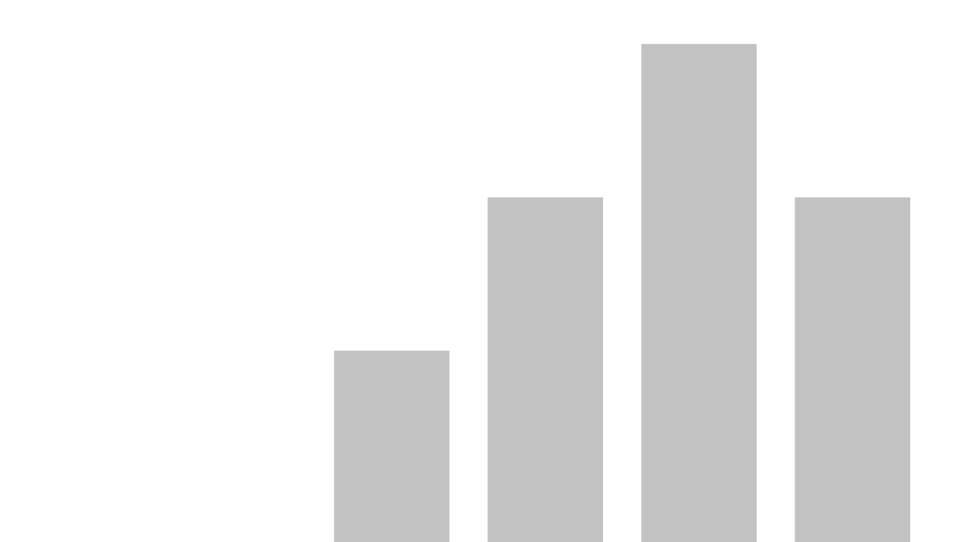


project(final)
View in Power BI
Last data refresh:
12/30/2024 7:23:18 PM UTC
Downloaded at:
12/30/2024 7:53:28 PM UTC

Slide 2
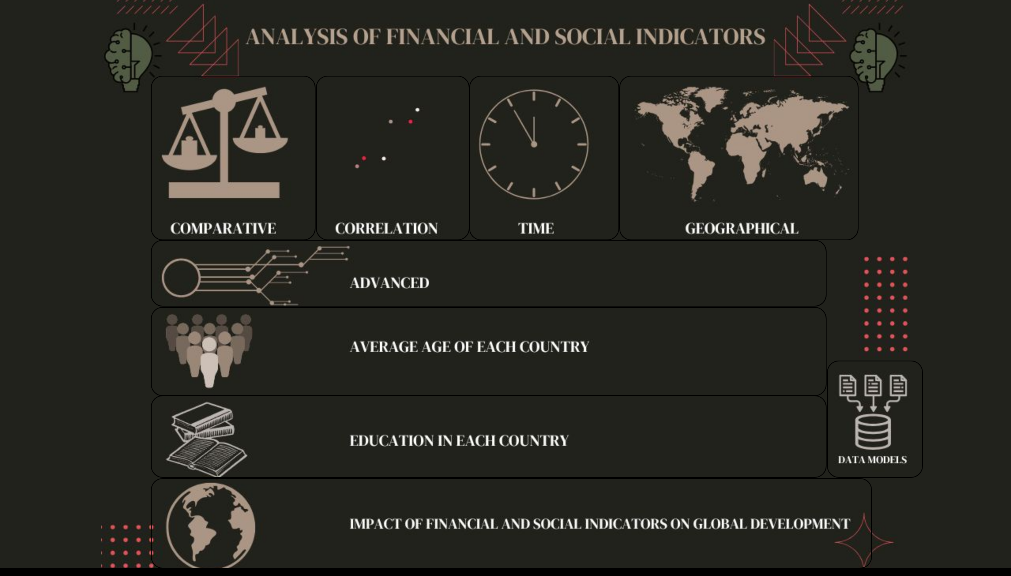
HomePage
Notes:
shape
No alt text provided
shape
No alt text provided
shape
No alt text provided
shape
No alt text provided
shape
No alt text provided
shape
No alt text provided
shape
No alt text provided
shape
No alt text provided
shape
No alt text provided

Slide 3
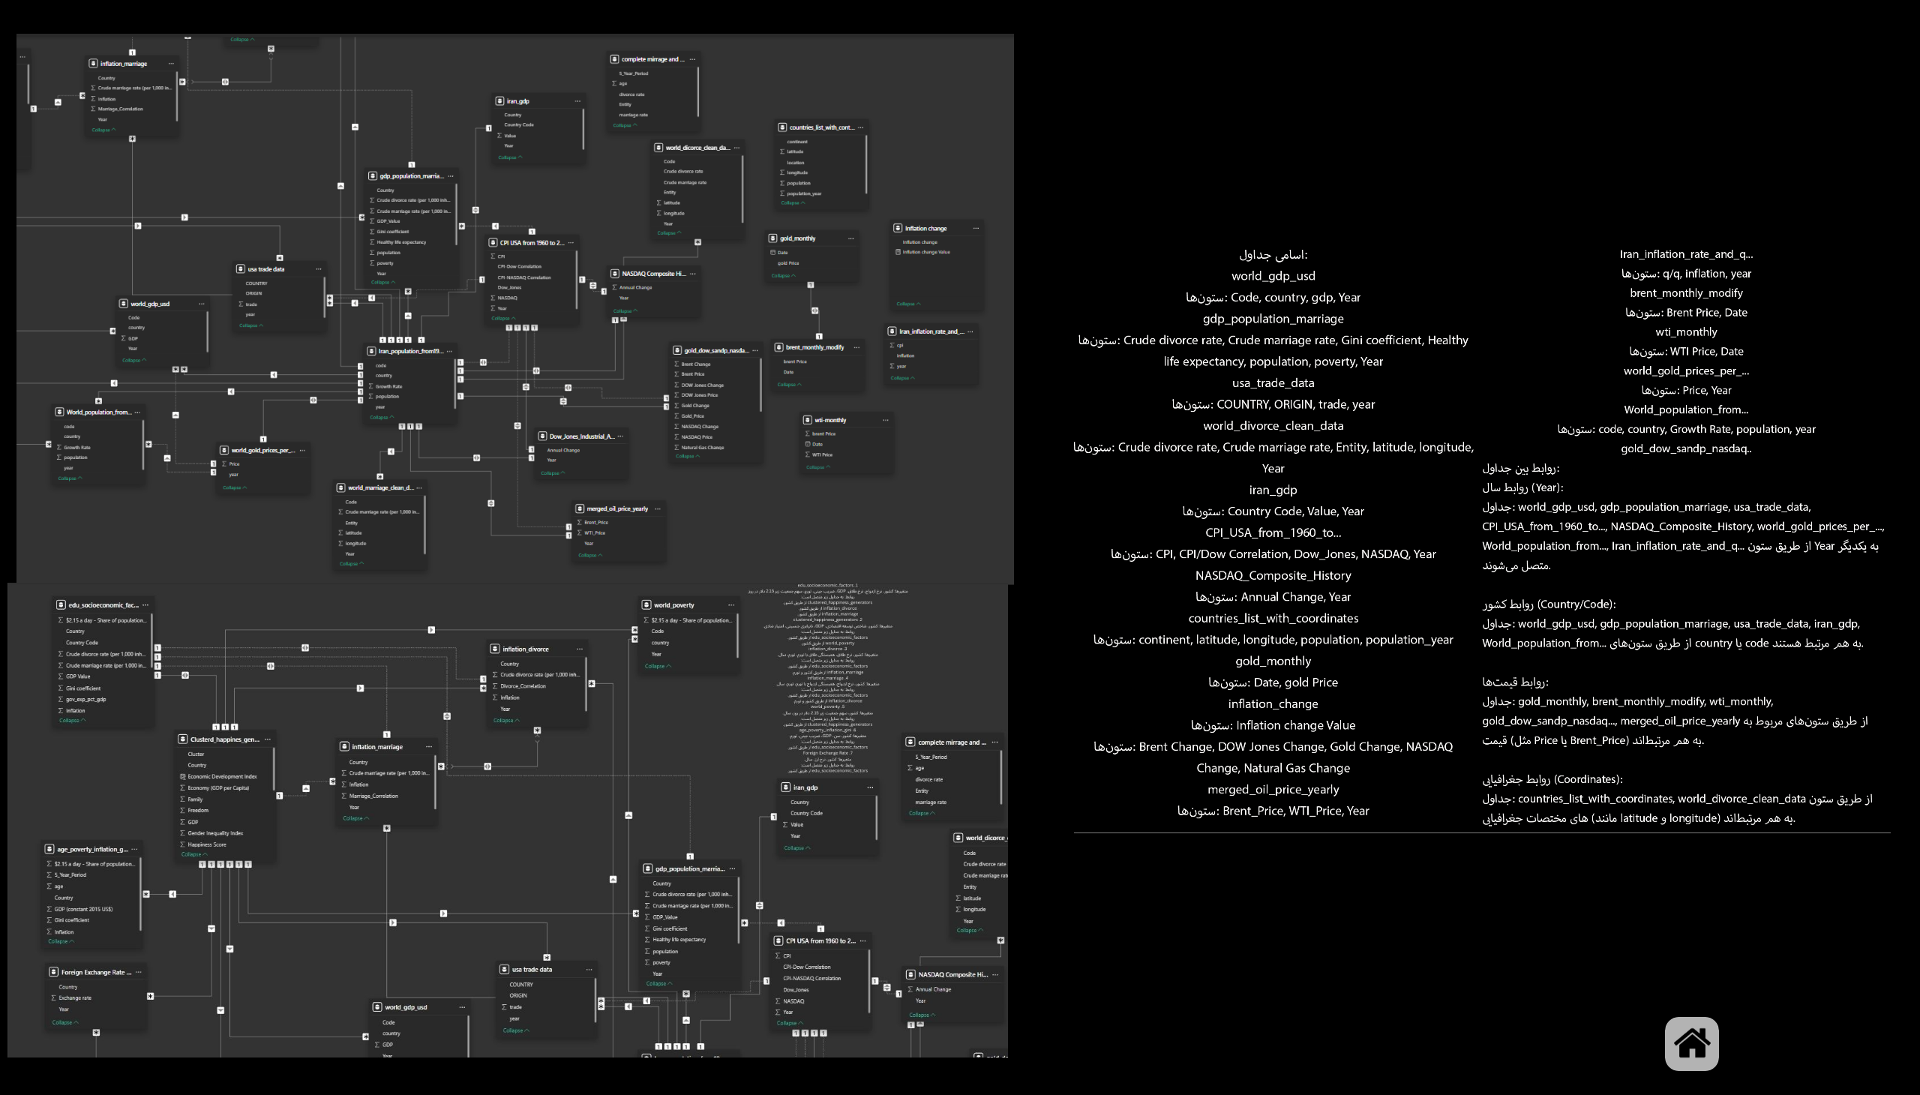
Page 0
Notes:
shape
No alt text provided
image
No alt text provided
image
No alt text provided
image
No alt text provided
image
No alt text provided

Slide 4
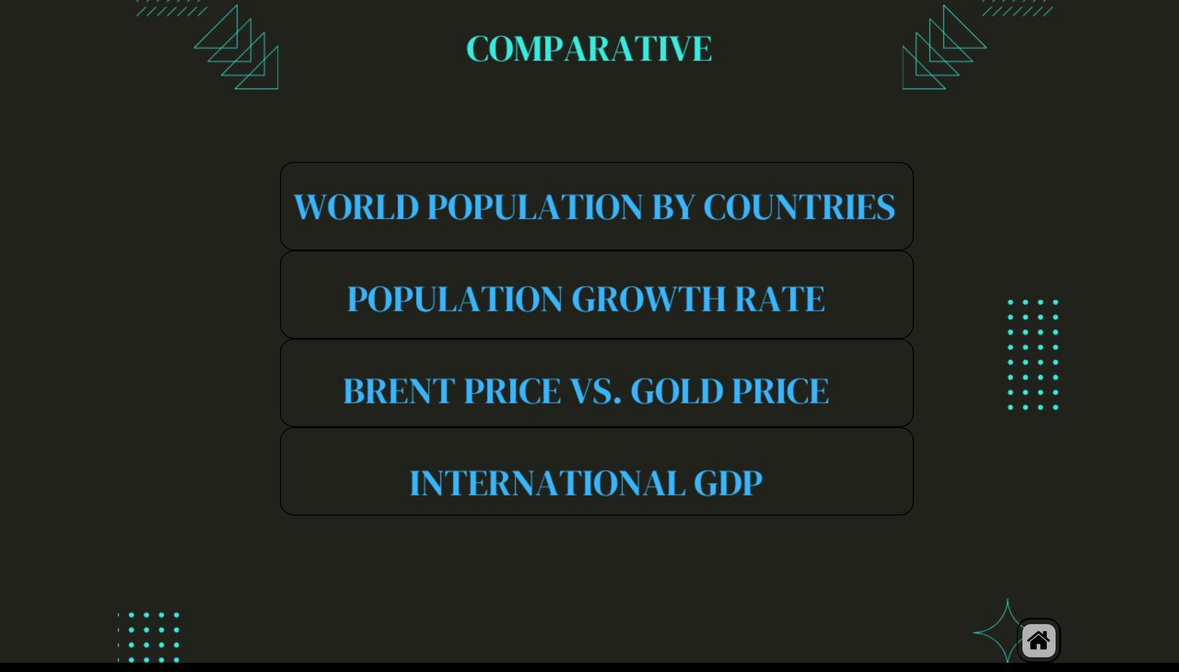
COMPARE
Notes:
shape
No alt text provided
shape
No alt text provided
shape
No alt text provided
shape
No alt text provided
shape
No alt text provided
image
No alt text provided

Slide 5
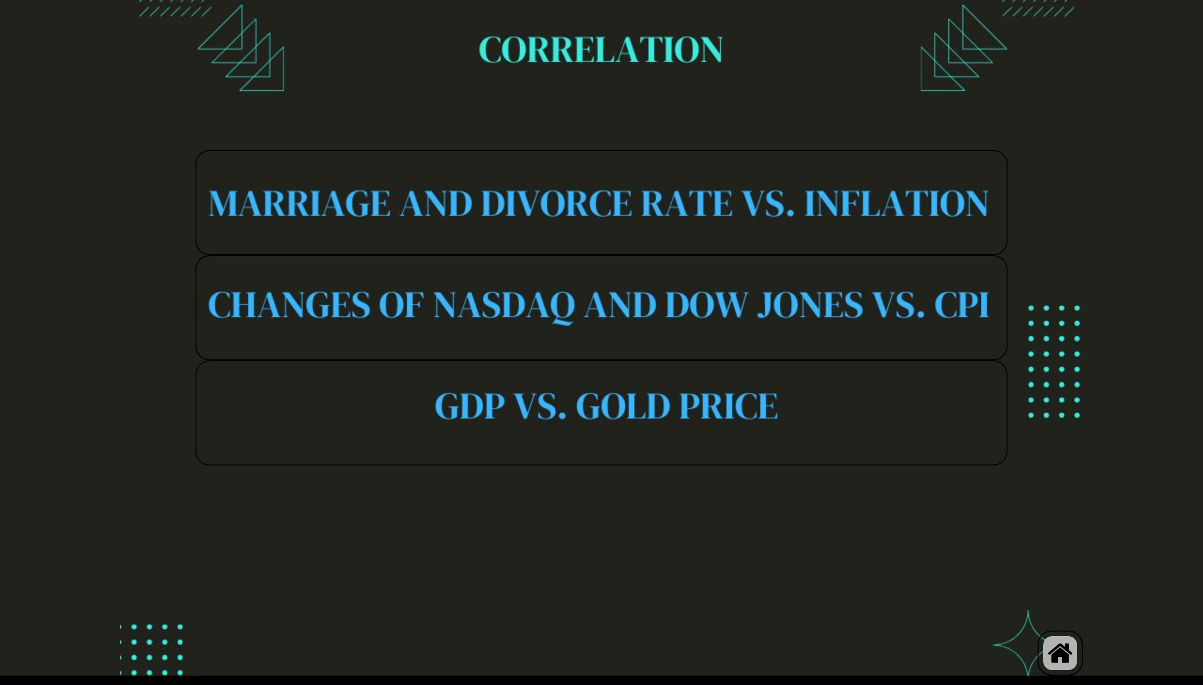
CORRELATION
Notes:
shape
No alt text provided
shape
No alt text provided
shape
No alt text provided
shape
No alt text provided
image
No alt text provided

Slide 6
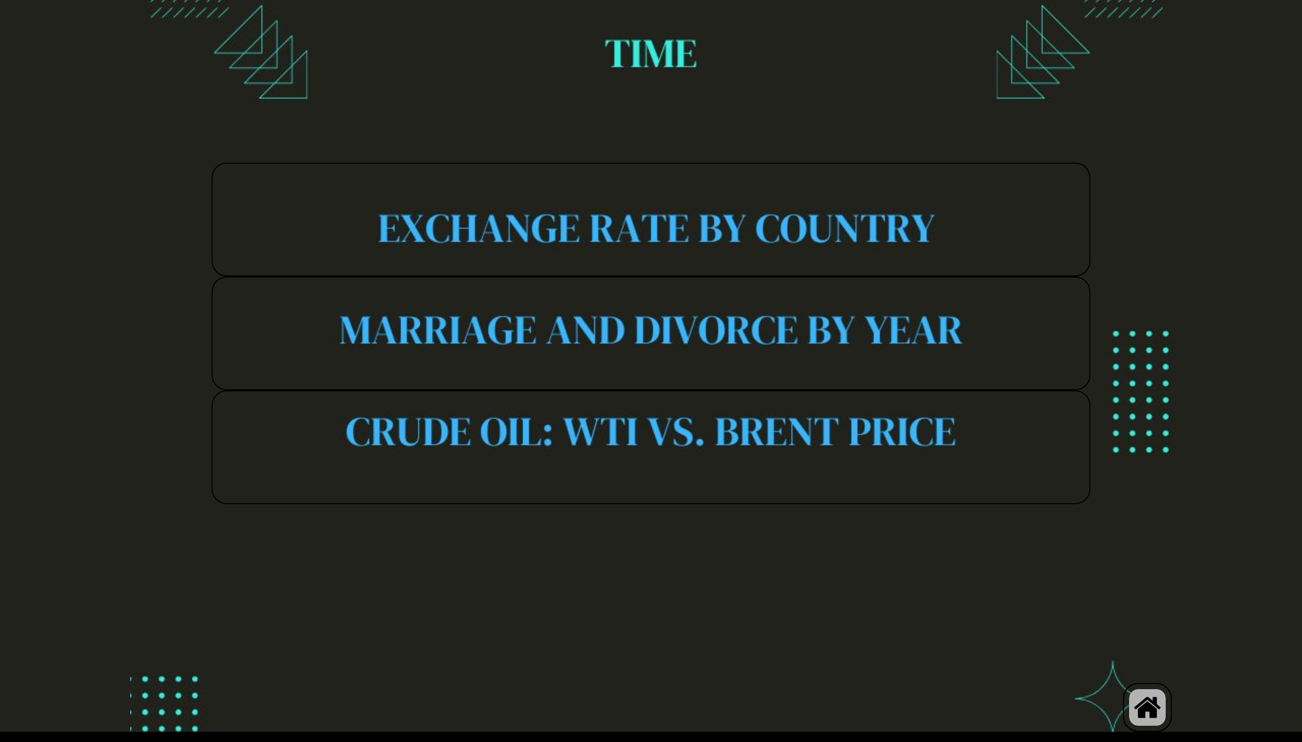
TIME
Notes:
shape
No alt text provided
shape
No alt text provided
shape
No alt text provided
shape
No alt text provided
image
No alt text provided

Slide 7
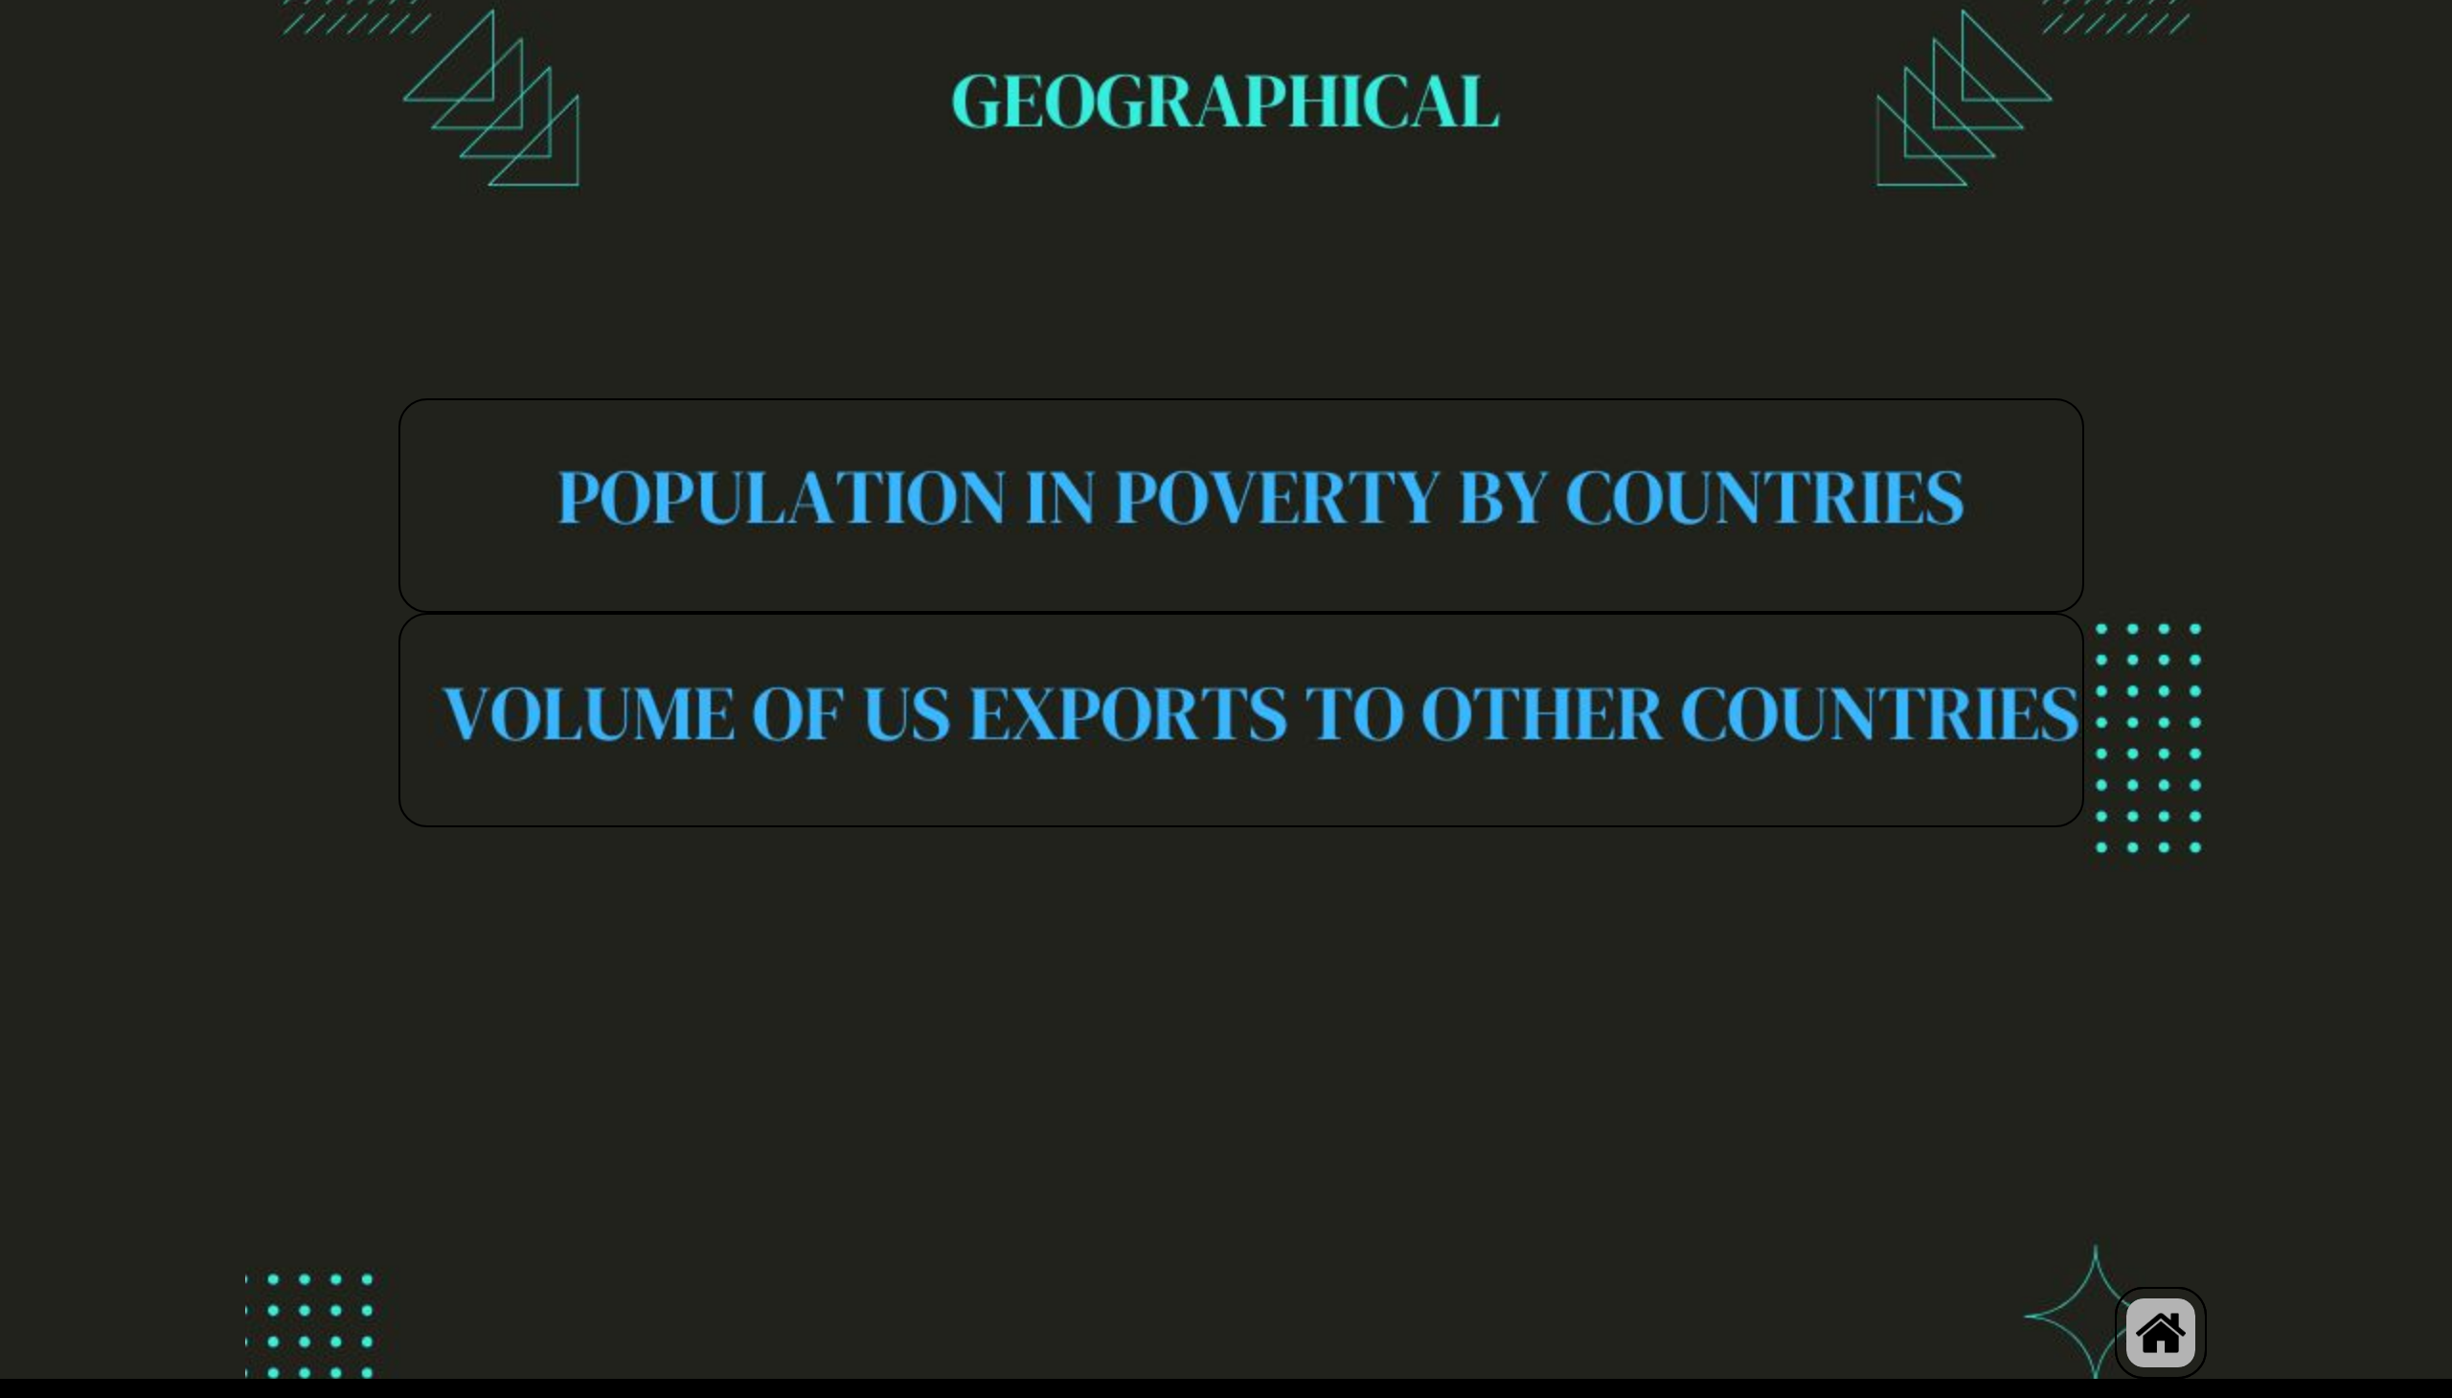
GEOGRAPHICAL
Notes:
shape
No alt text provided
shape
No alt text provided
shape
No alt text provided
image
No alt text provided

Slide 8
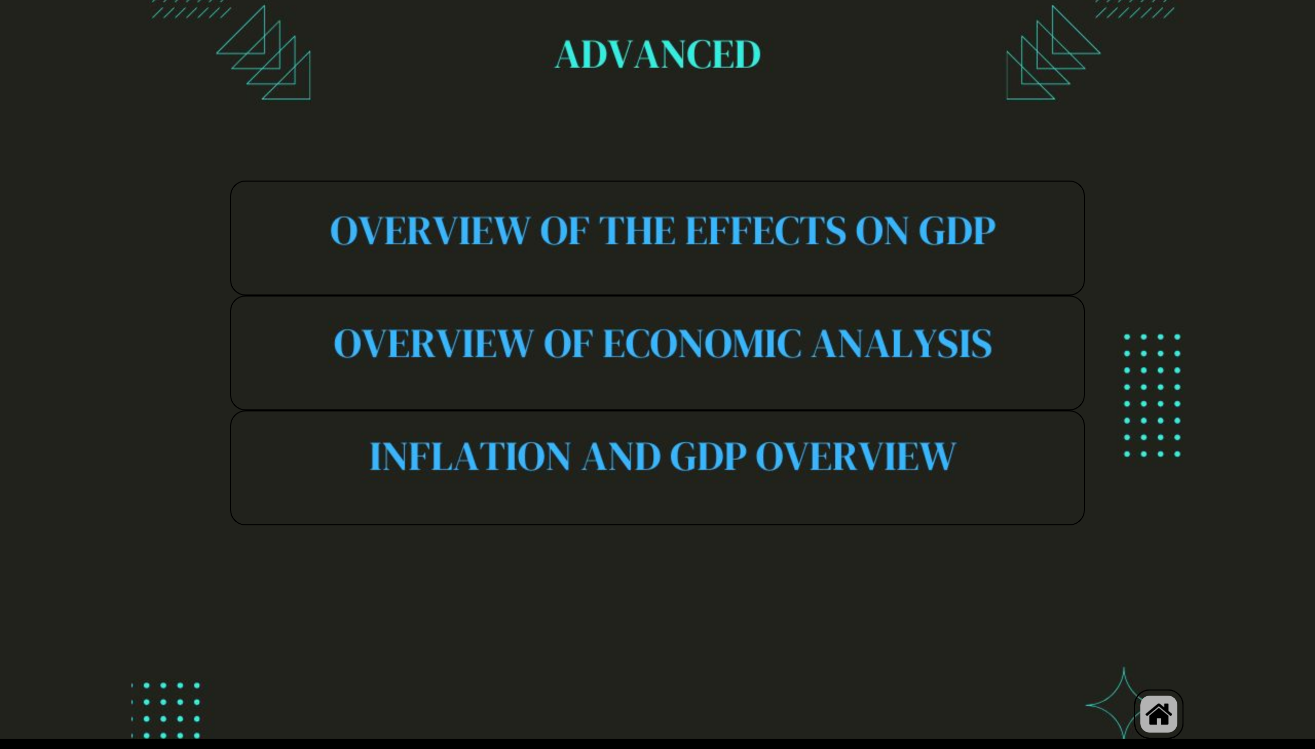
ADVANCED
Notes:
shape
No alt text provided
shape
No alt text provided
shape
No alt text provided
shape
No alt text provided
image
No alt text provided

Slide 9
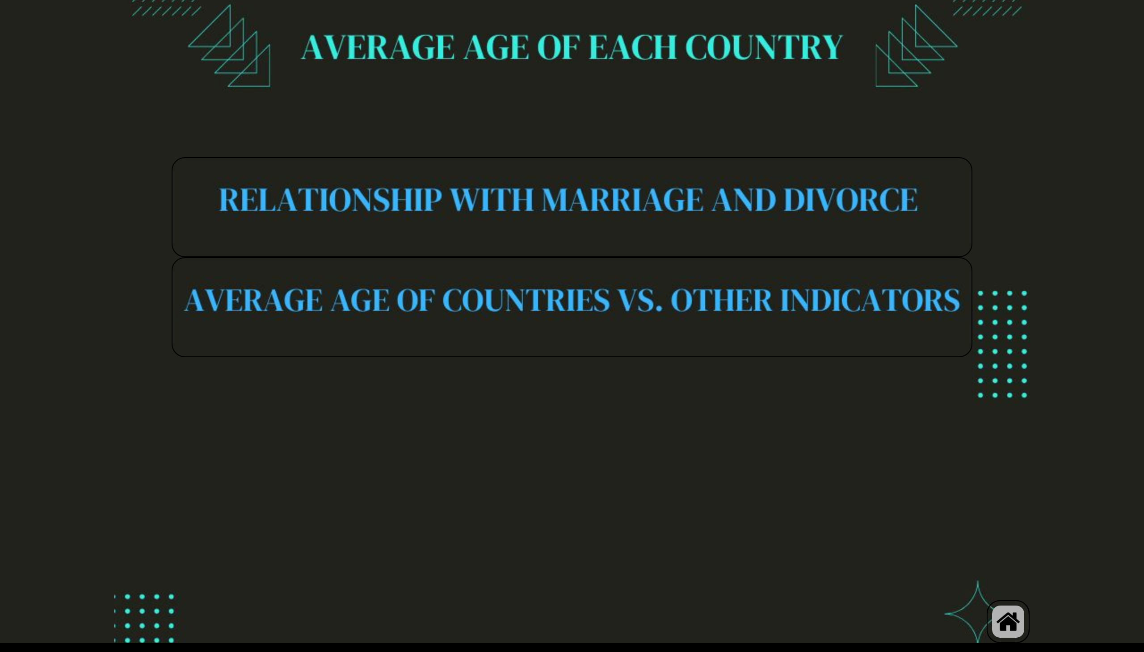
AVERAGE AGE OF EACH COUNTRY
Notes:
shape
No alt text provided
shape
No alt text provided
shape
No alt text provided
image
No alt text provided

Slide 10
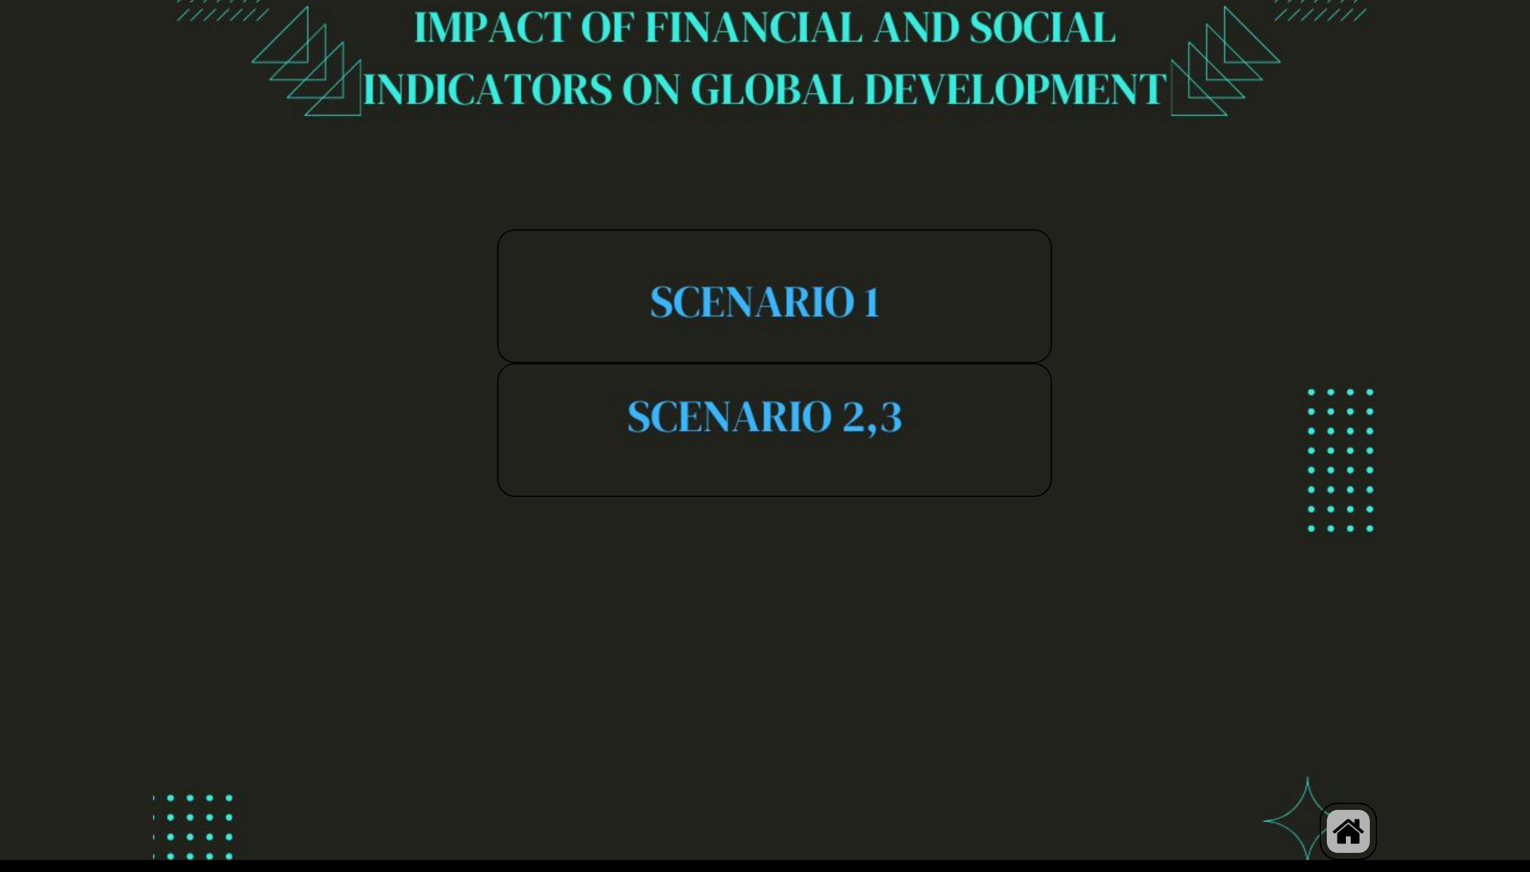
IMPACT OF FINANCIAL ON GLOBAL DEV
Notes:
shape
No alt text provided
shape
No alt text provided
shape
No alt text provided
image
No alt text provided

Slide 11
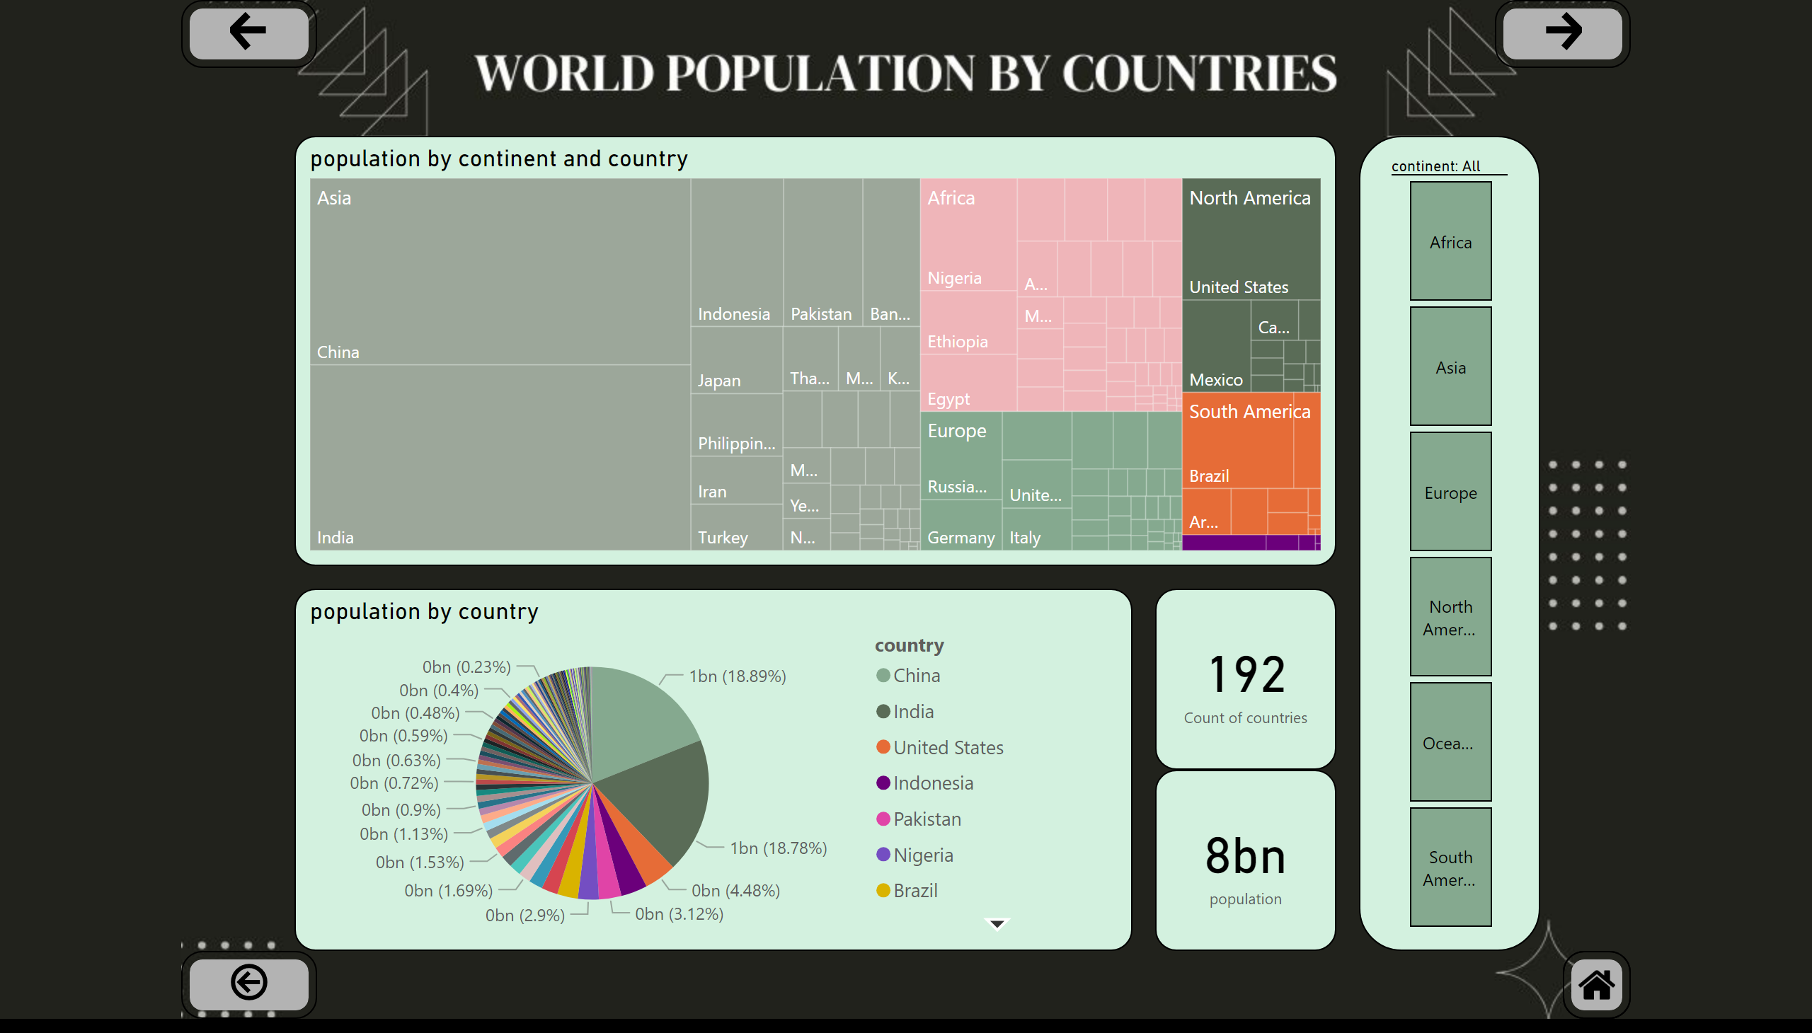
compare populations
Notes:
treemap
No alt text provided
slicer
No alt text provided
pieChart
No alt text provided
card
No alt text provided
card
No alt text provided
actionButton
No alt text provided
actionButton
No alt text provided
actionButton
No alt text provided
shape
No alt text provided
image
No alt text provided

Slide 12
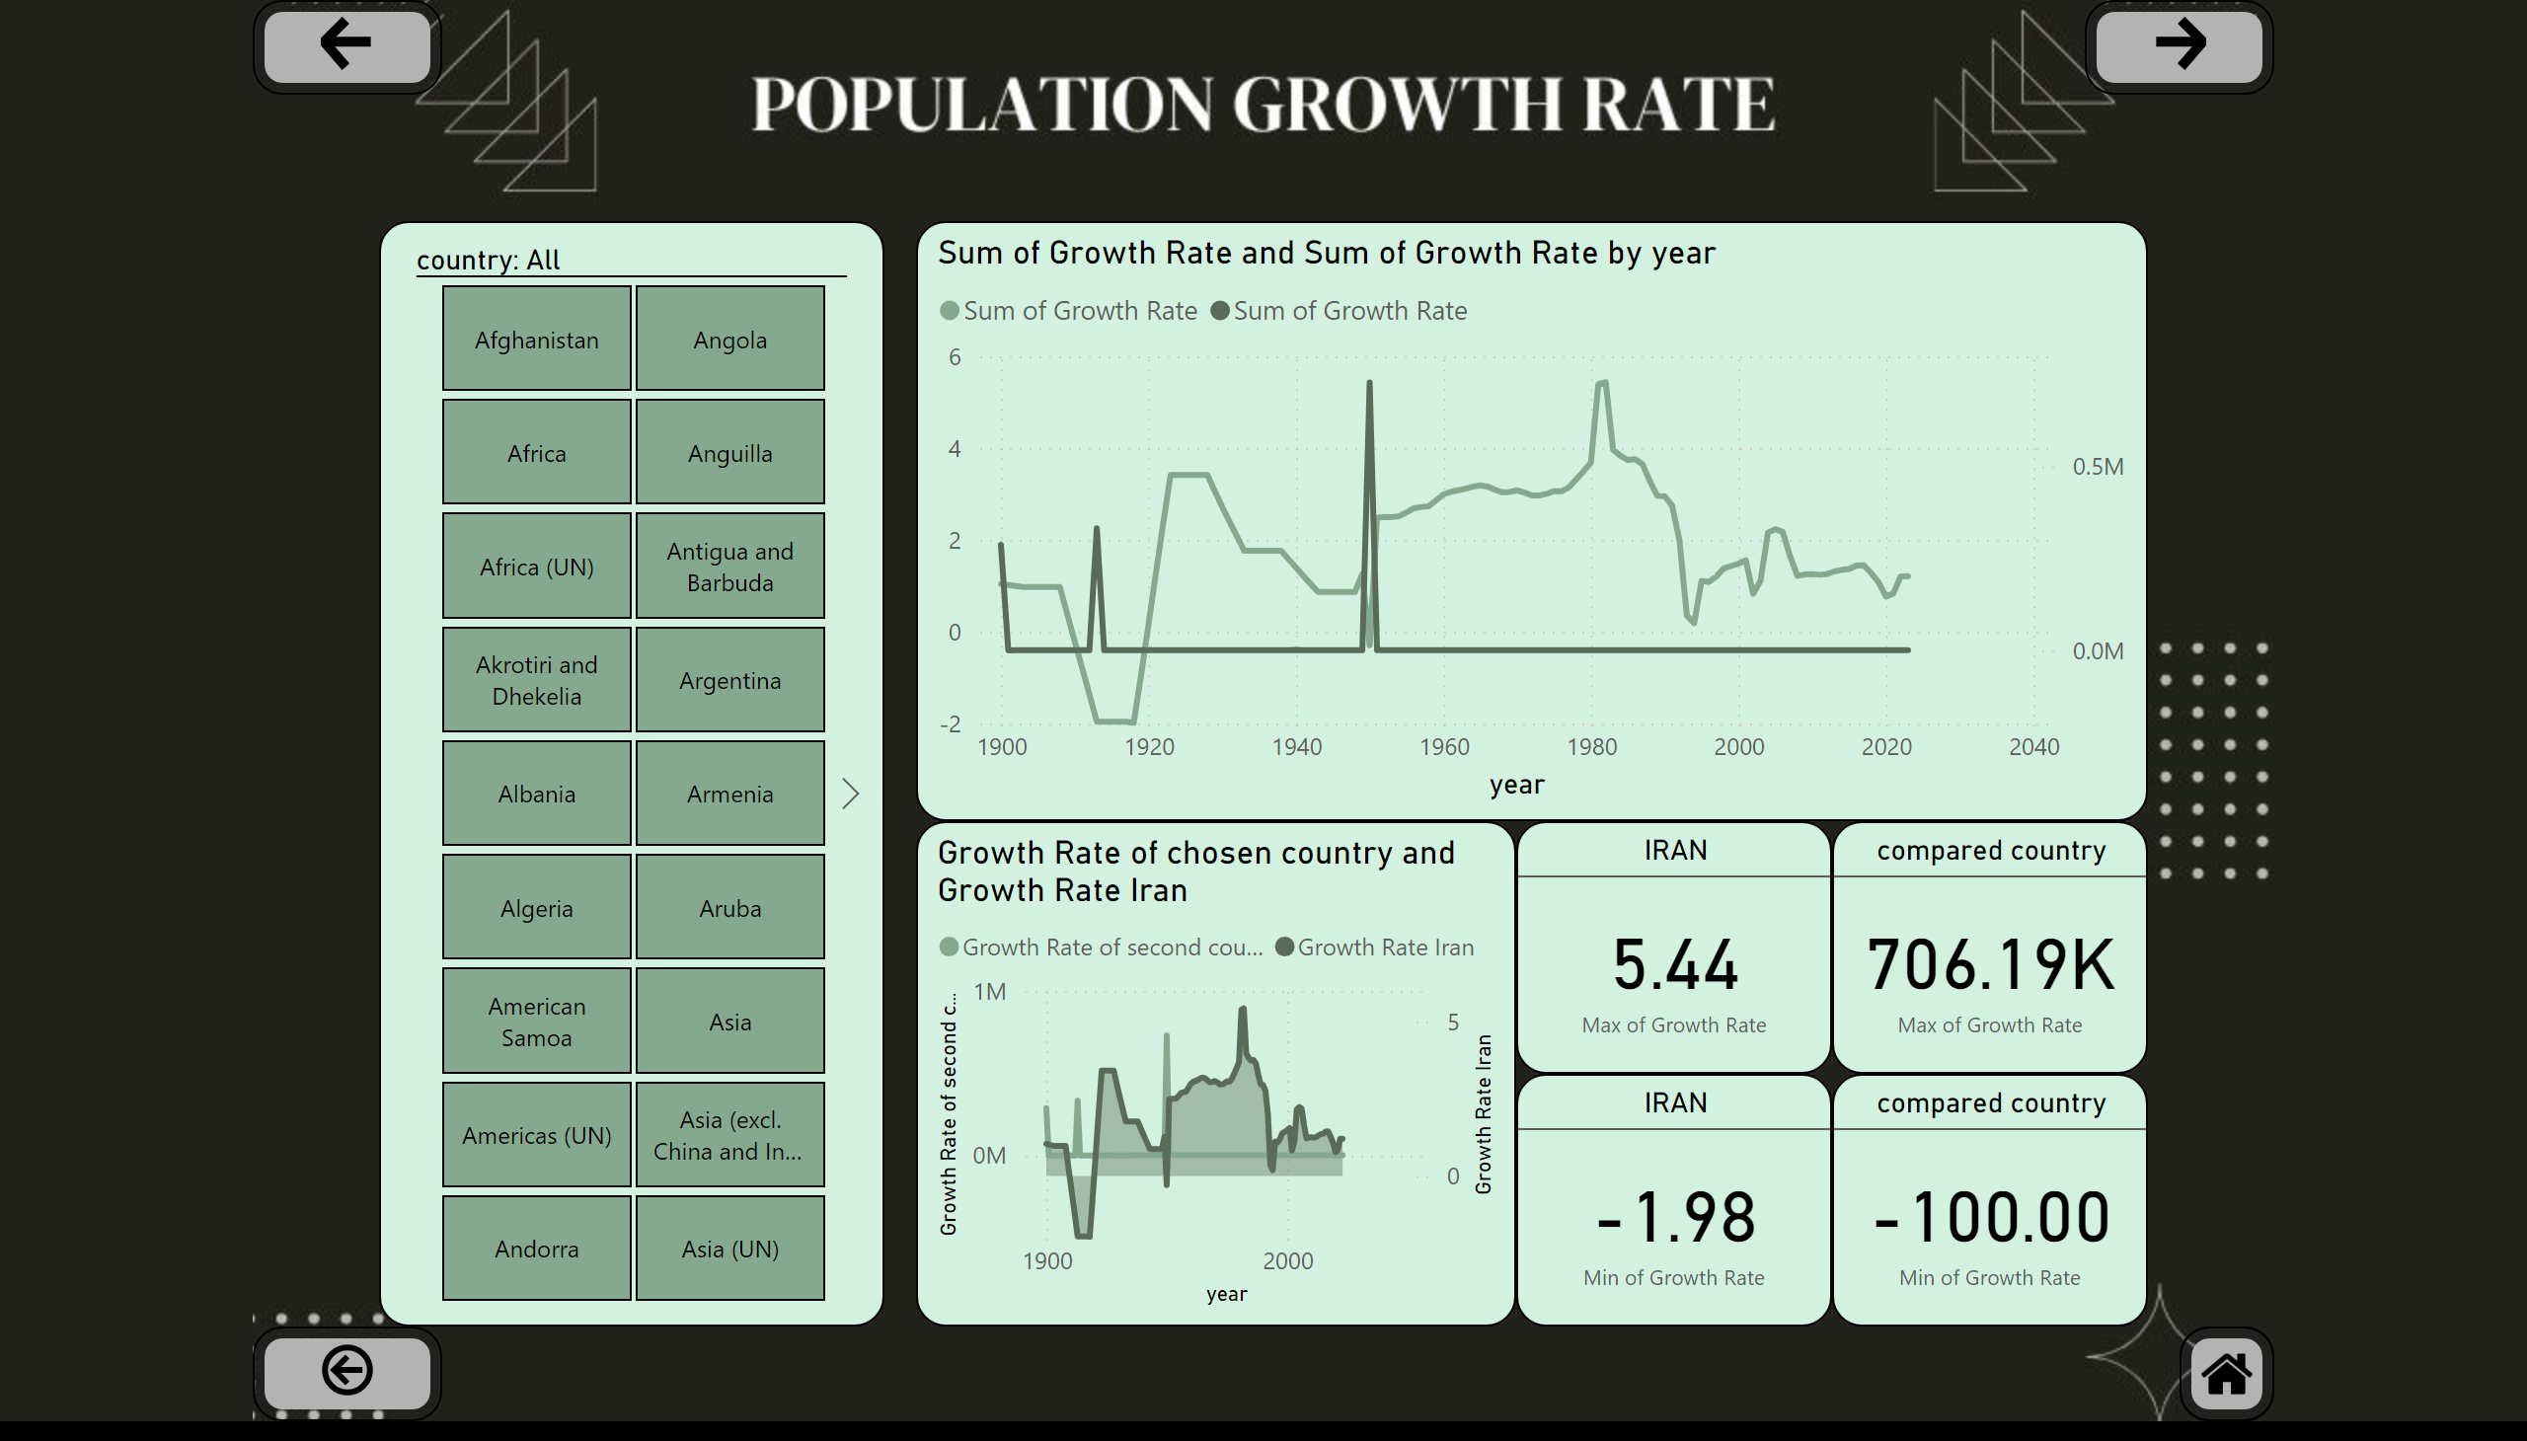
compare growth rate of Iran and other countries
Notes:
lineChart
No alt text provided
slicer
No alt text provided
Growth Rate of chosen country and Growth Rate Iran
No alt text provided
IRAN
No alt text provided
IRAN
No alt text provided
compared country
No alt text provided
compared country
No alt text provided
actionButton
No alt text provided
actionButton
No alt text provided
actionButton
No alt text provided
shape
No alt text provided
image
No alt text provided

Slide 13
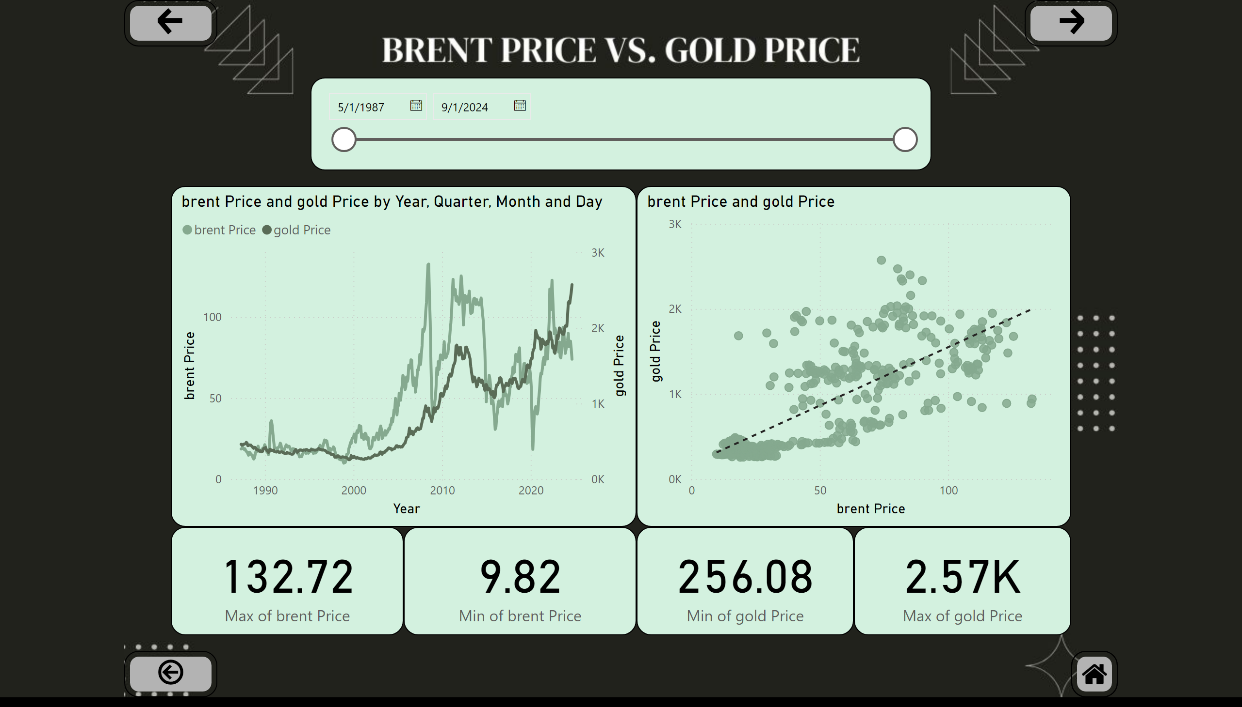
compare brent and gold price
Notes:
lineChart
No alt text provided
slicer
No alt text provided
scatterChart
No alt text provided
card
No alt text provided
card
No alt text provided
card
No alt text provided
card
No alt text provided
actionButton
No alt text provided
actionButton
No alt text provided
actionButton
No alt text provided
shape
No alt text provided
image
No alt text provided

Slide 14
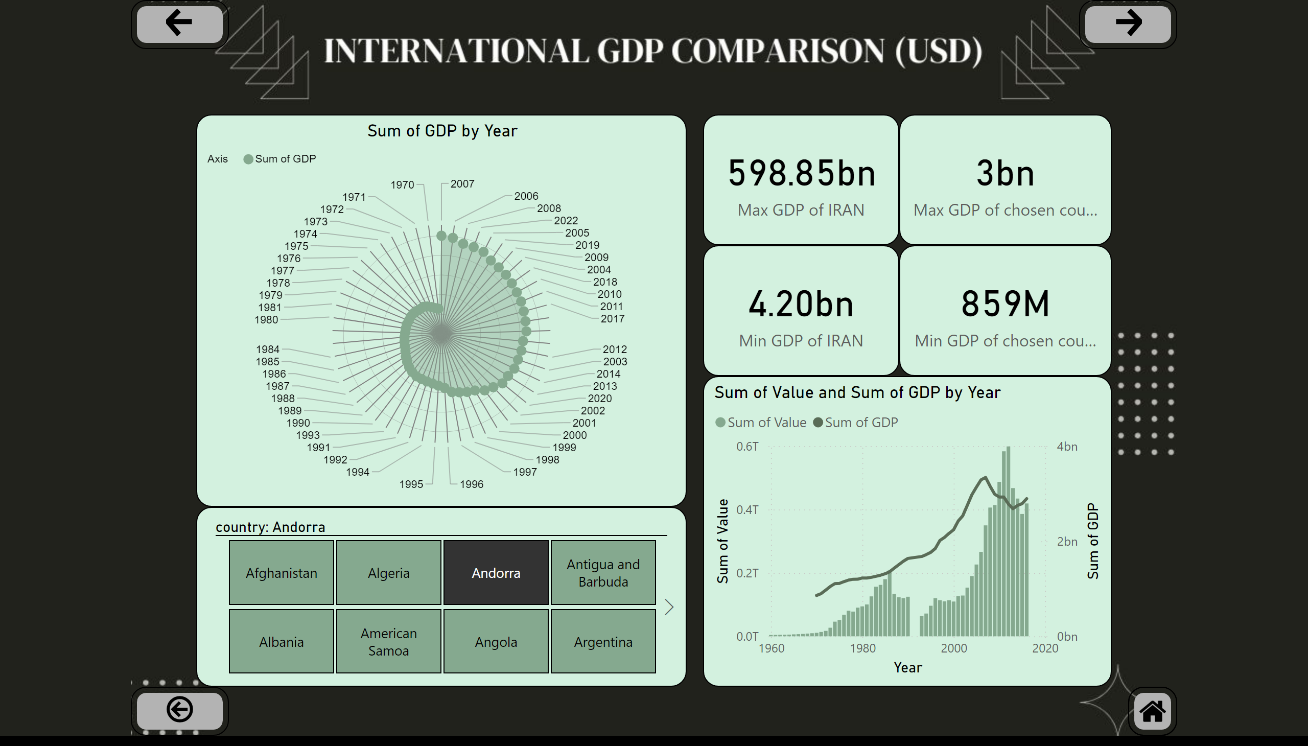
compare GDP of Iran and other countries
Notes:
lineClusteredColumnComboChart
No alt text provided
slicer
No alt text provided
card
No alt text provided
card
No alt text provided
card
No alt text provided
card
No alt text provided
RadarChart1446119667547
No alt text provided
actionButton
No alt text provided
actionButton
No alt text provided
actionButton
No alt text provided
shape
No alt text provided
image
No alt text provided

Slide 15
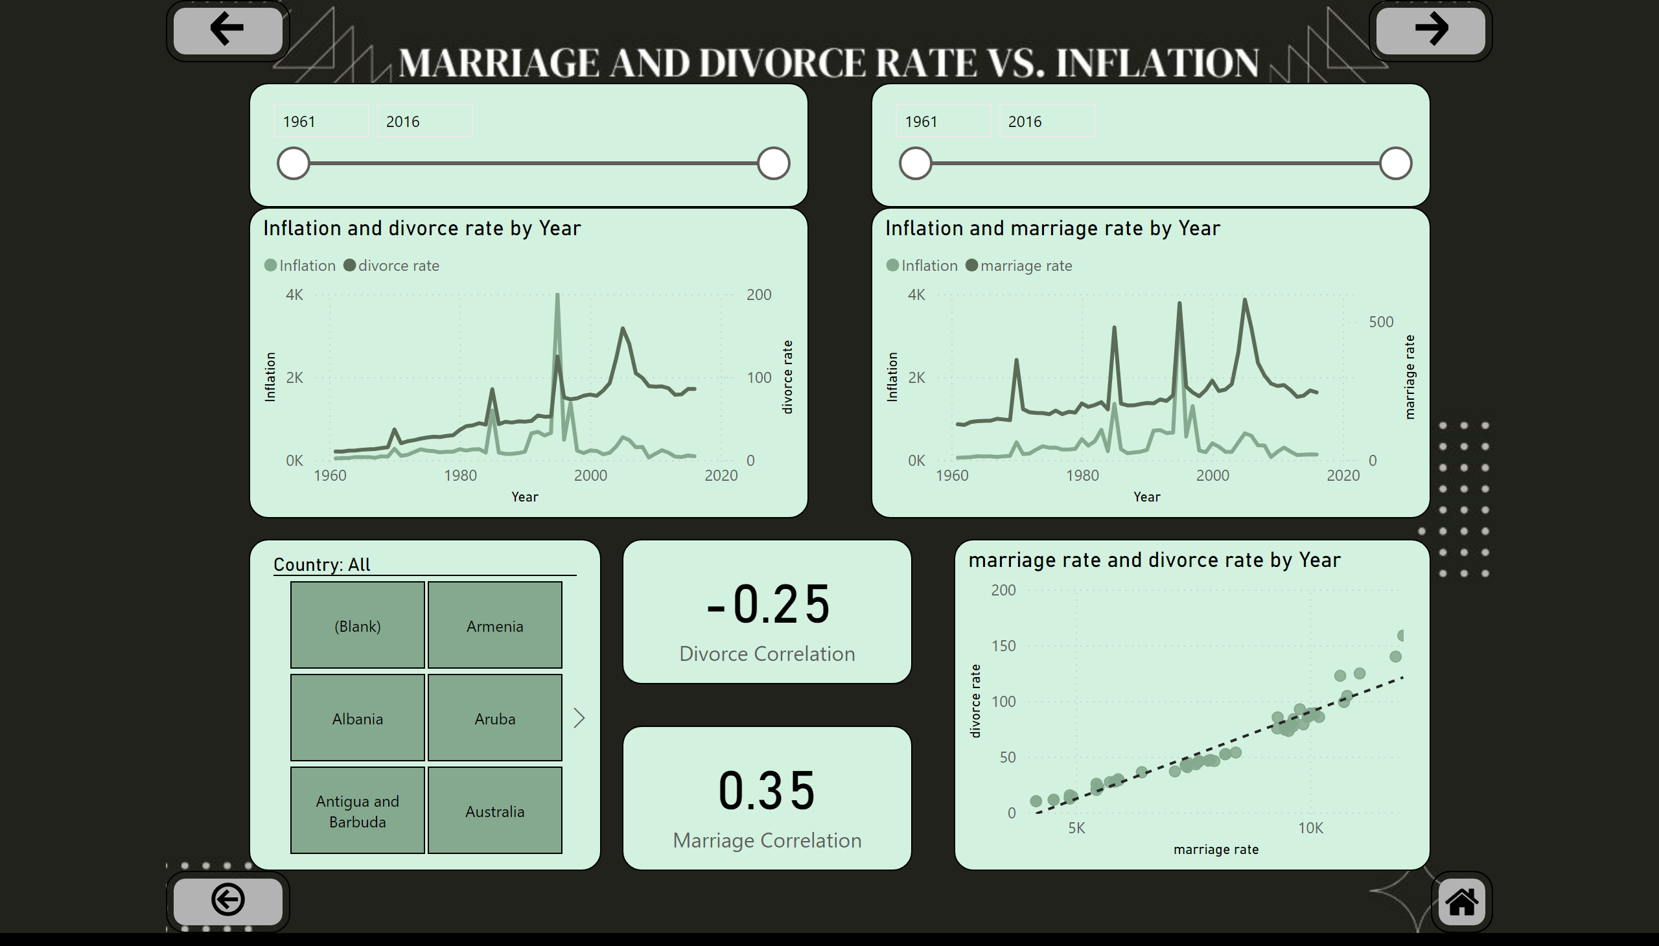
divorce and marriage correlation
Notes:
scatterChart
No alt text provided
lineChart
No alt text provided
lineChart
No alt text provided
slicer
No alt text provided
card
No alt text provided
card
No alt text provided
slicer
No alt text provided
slicer
No alt text provided
actionButton
No alt text provided
actionButton
No alt text provided
actionButton
No alt text provided
shape
No alt text provided
image
No alt text provided

Slide 16
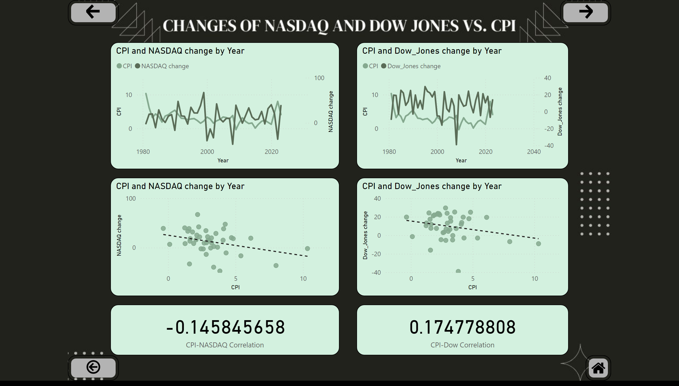
CPI with Dow and NAZDAQ correlation
Notes:
lineChart
No alt text provided
lineChart
No alt text provided
scatterChart
No alt text provided
scatterChart
No alt text provided
card
No alt text provided
card
No alt text provided
actionButton
No alt text provided
actionButton
No alt text provided
actionButton
No alt text provided
shape
No alt text provided
image
No alt text provided

Slide 17
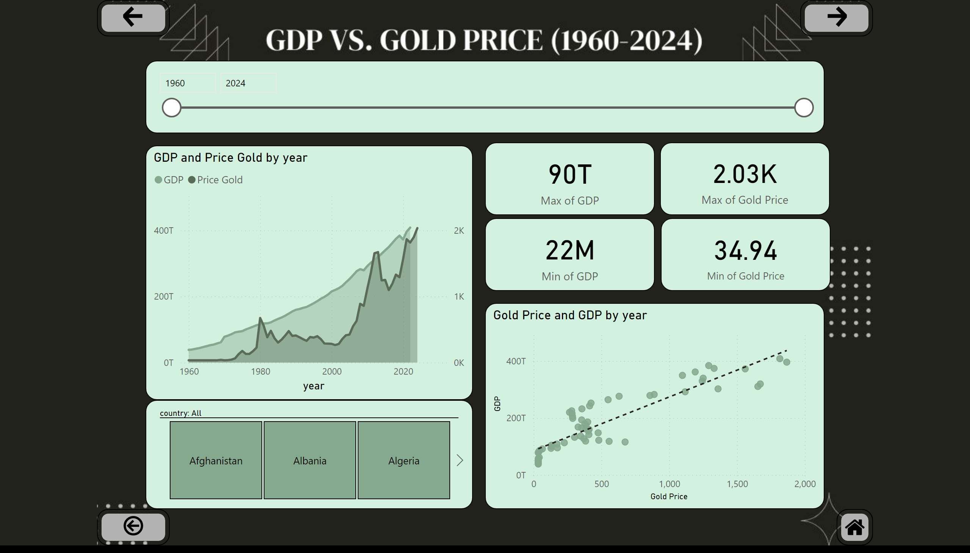
GDP and gold price correlation
Notes:
areaChart
No alt text provided
slicer
No alt text provided
slicer
No alt text provided
card
No alt text provided
card
No alt text provided
card
No alt text provided
card
No alt text provided
scatterChart
No alt text provided
actionButton
No alt text provided
actionButton
No alt text provided
actionButton
No alt text provided
shape
No alt text provided
image
No alt text provided

Slide 18
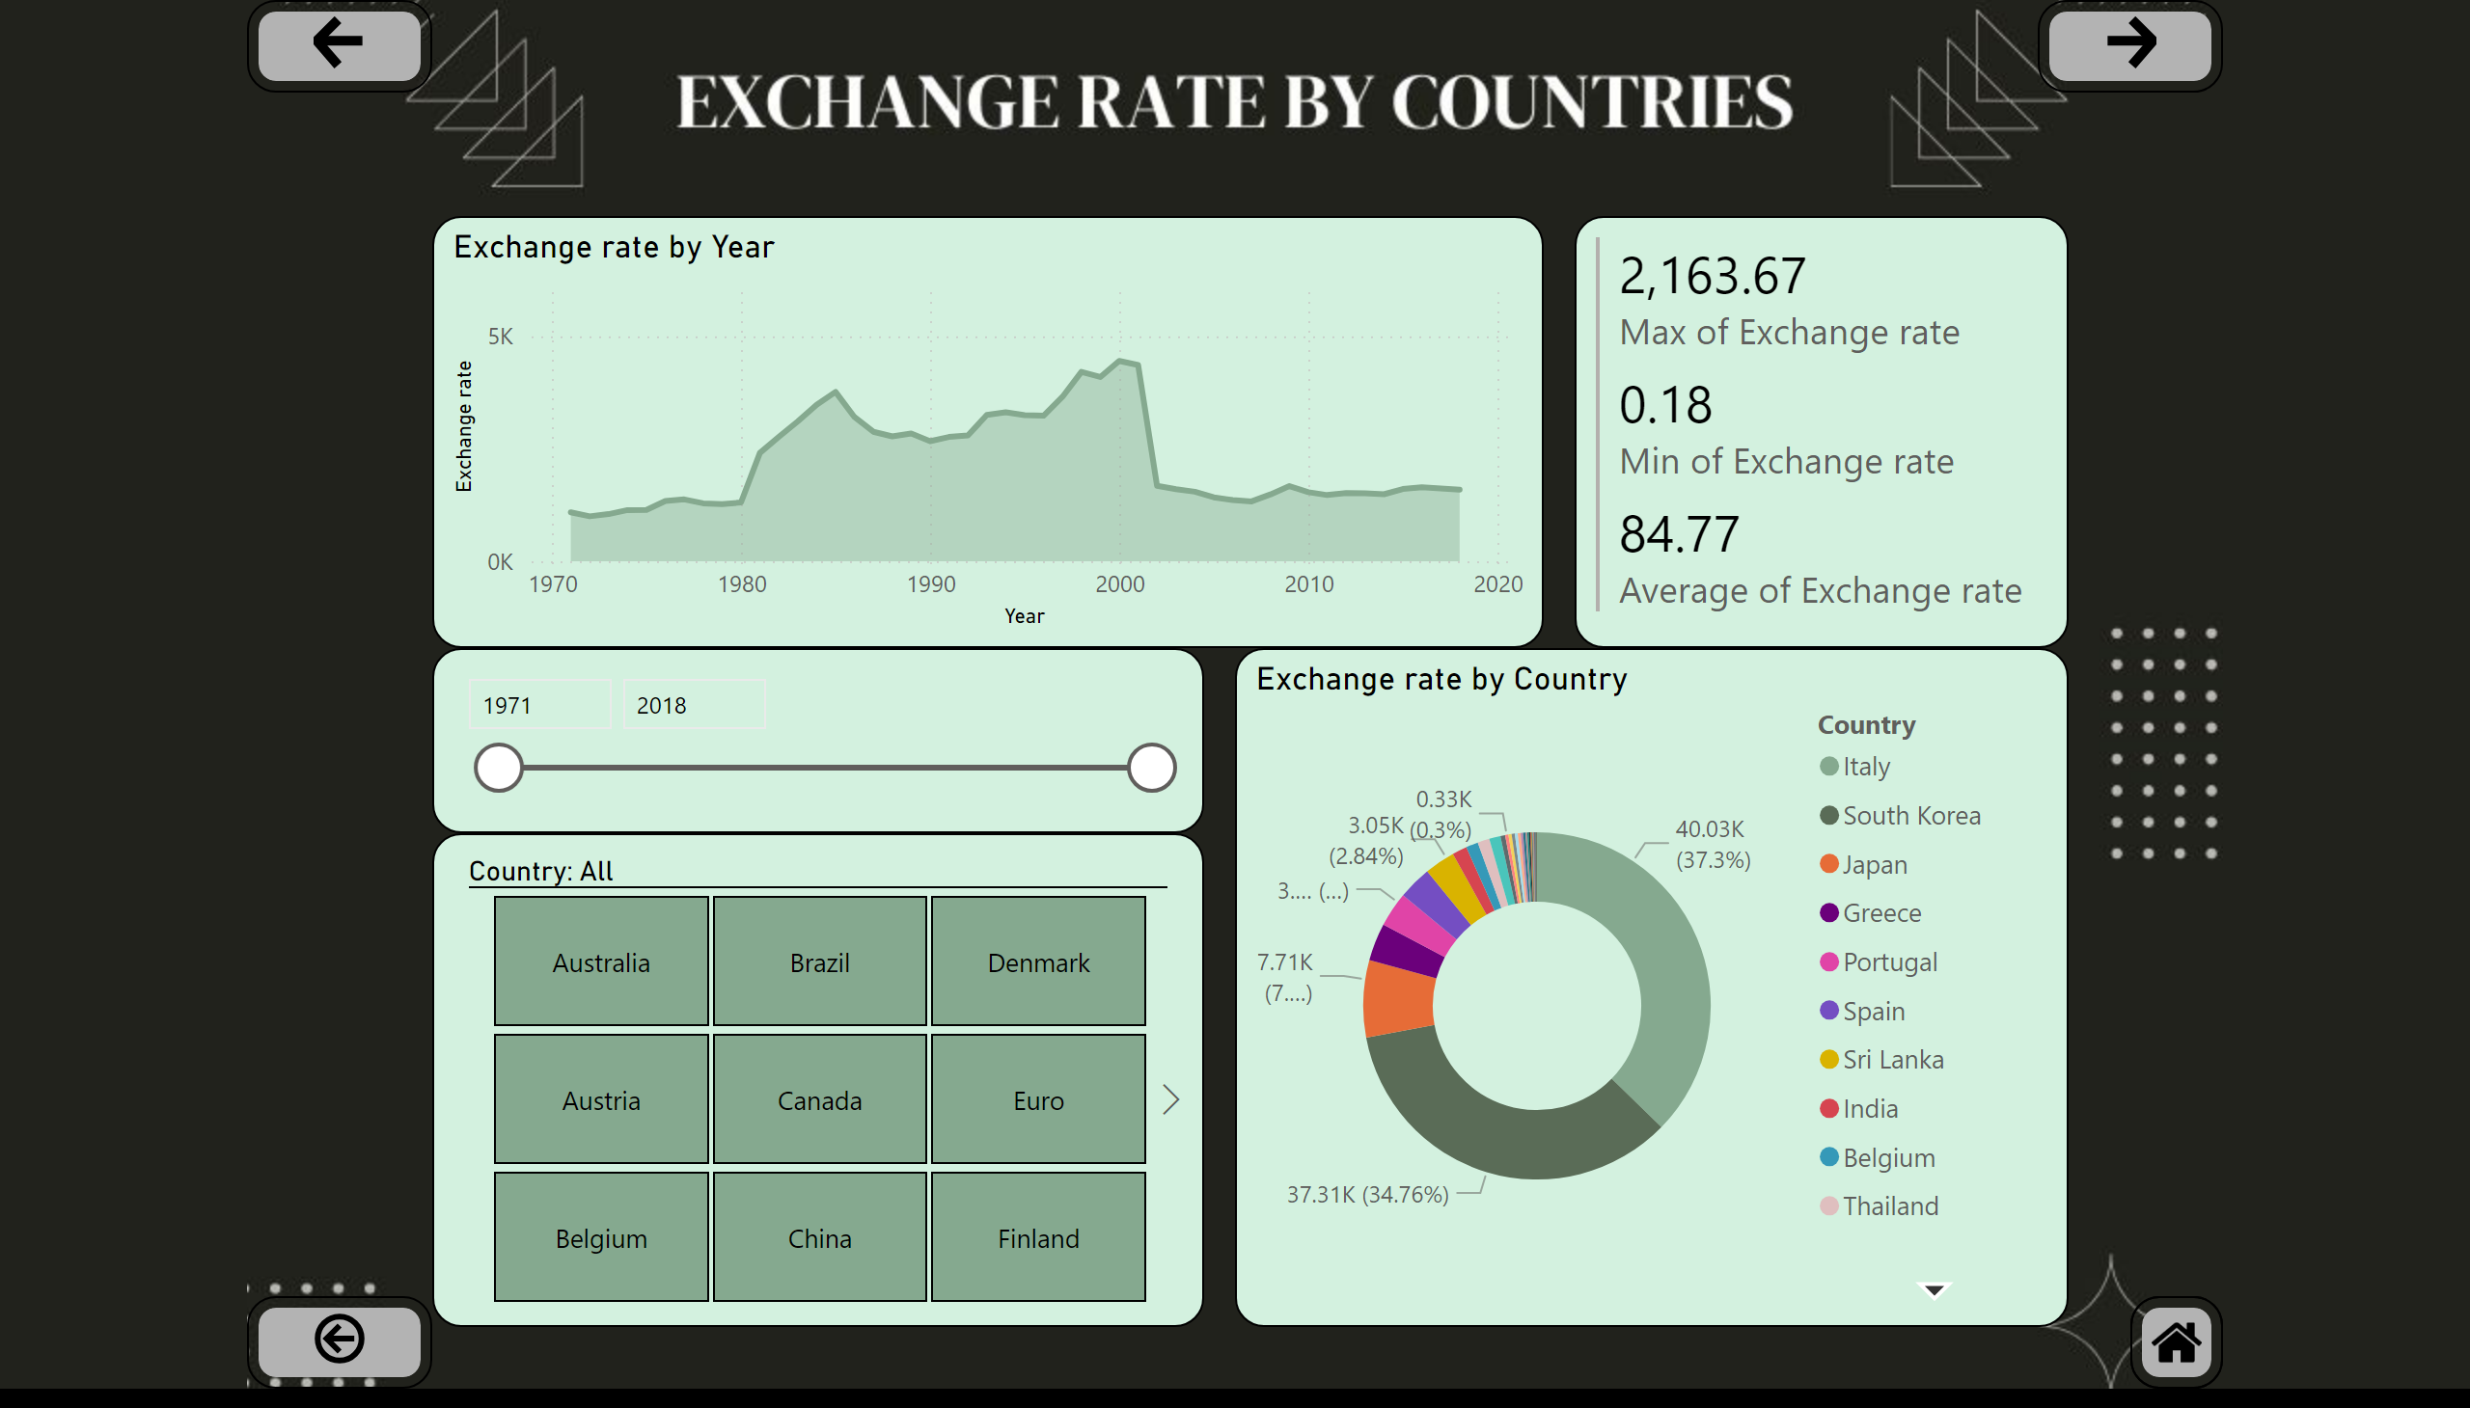
exchange rate time analysis
Notes:
areaChart
No alt text provided
slicer
No alt text provided
donutChart
No alt text provided
slicer
No alt text provided
multiRowCard
No alt text provided
actionButton
No alt text provided
actionButton
No alt text provided
actionButton
No alt text provided
shape
No alt text provided
image
No alt text provided

Slide 19
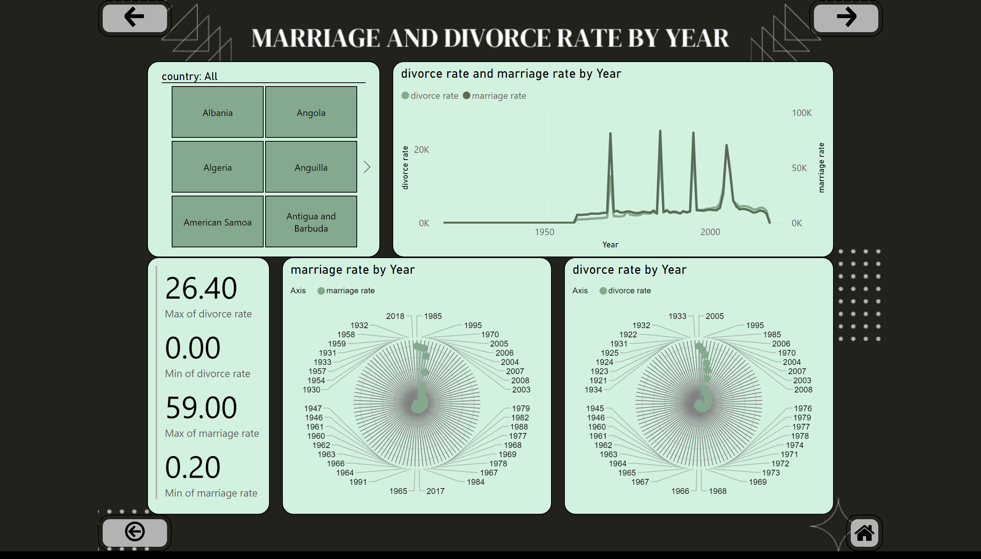
divorce and marriage rate time analysis
Notes:
lineChart
No alt text provided
slicer
No alt text provided
RadarChart1446119667547
No alt text provided
RadarChart1446119667547
No alt text provided
multiRowCard
No alt text provided
actionButton
No alt text provided
actionButton
No alt text provided
actionButton
No alt text provided
shape
No alt text provided
image
No alt text provided

Slide 20
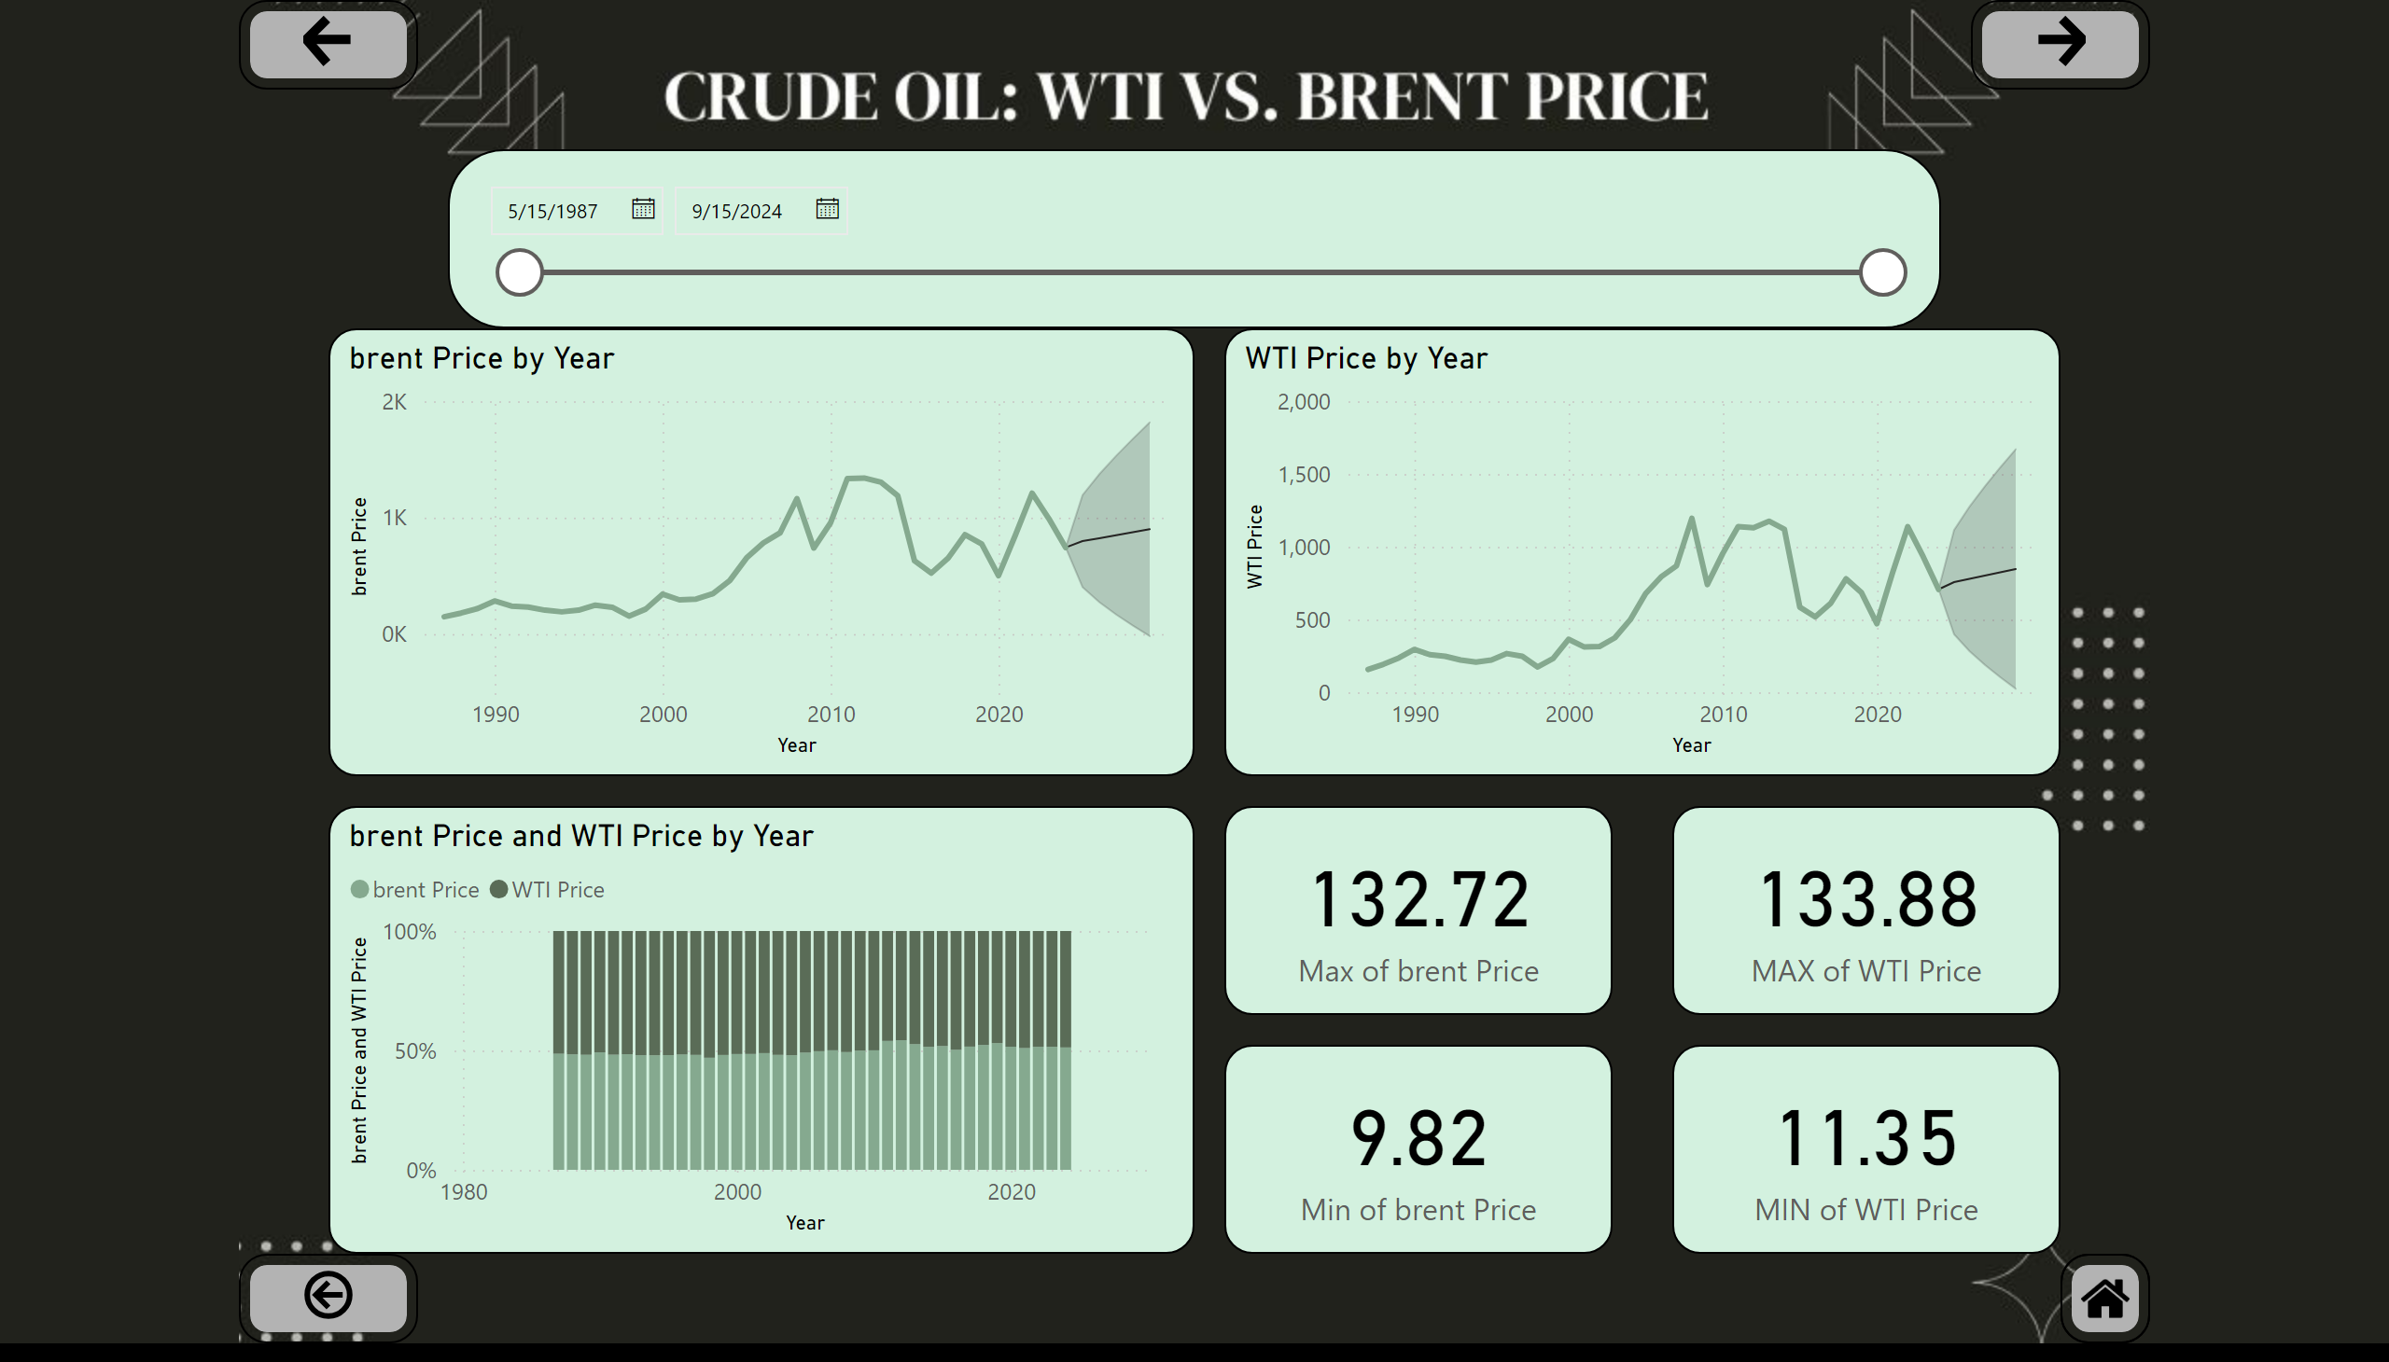
oil time analysis
Notes:
lineChart
No alt text provided
lineChart
No alt text provided
hundredPercentStackedColumnChart
No alt text provided
slicer
No alt text provided
card
No alt text provided
card
No alt text provided
card
No alt text provided
card
No alt text provided
actionButton
No alt text provided
actionButton
No alt text provided
actionButton
No alt text provided
shape
No alt text provided
image
No alt text provided

Slide 21
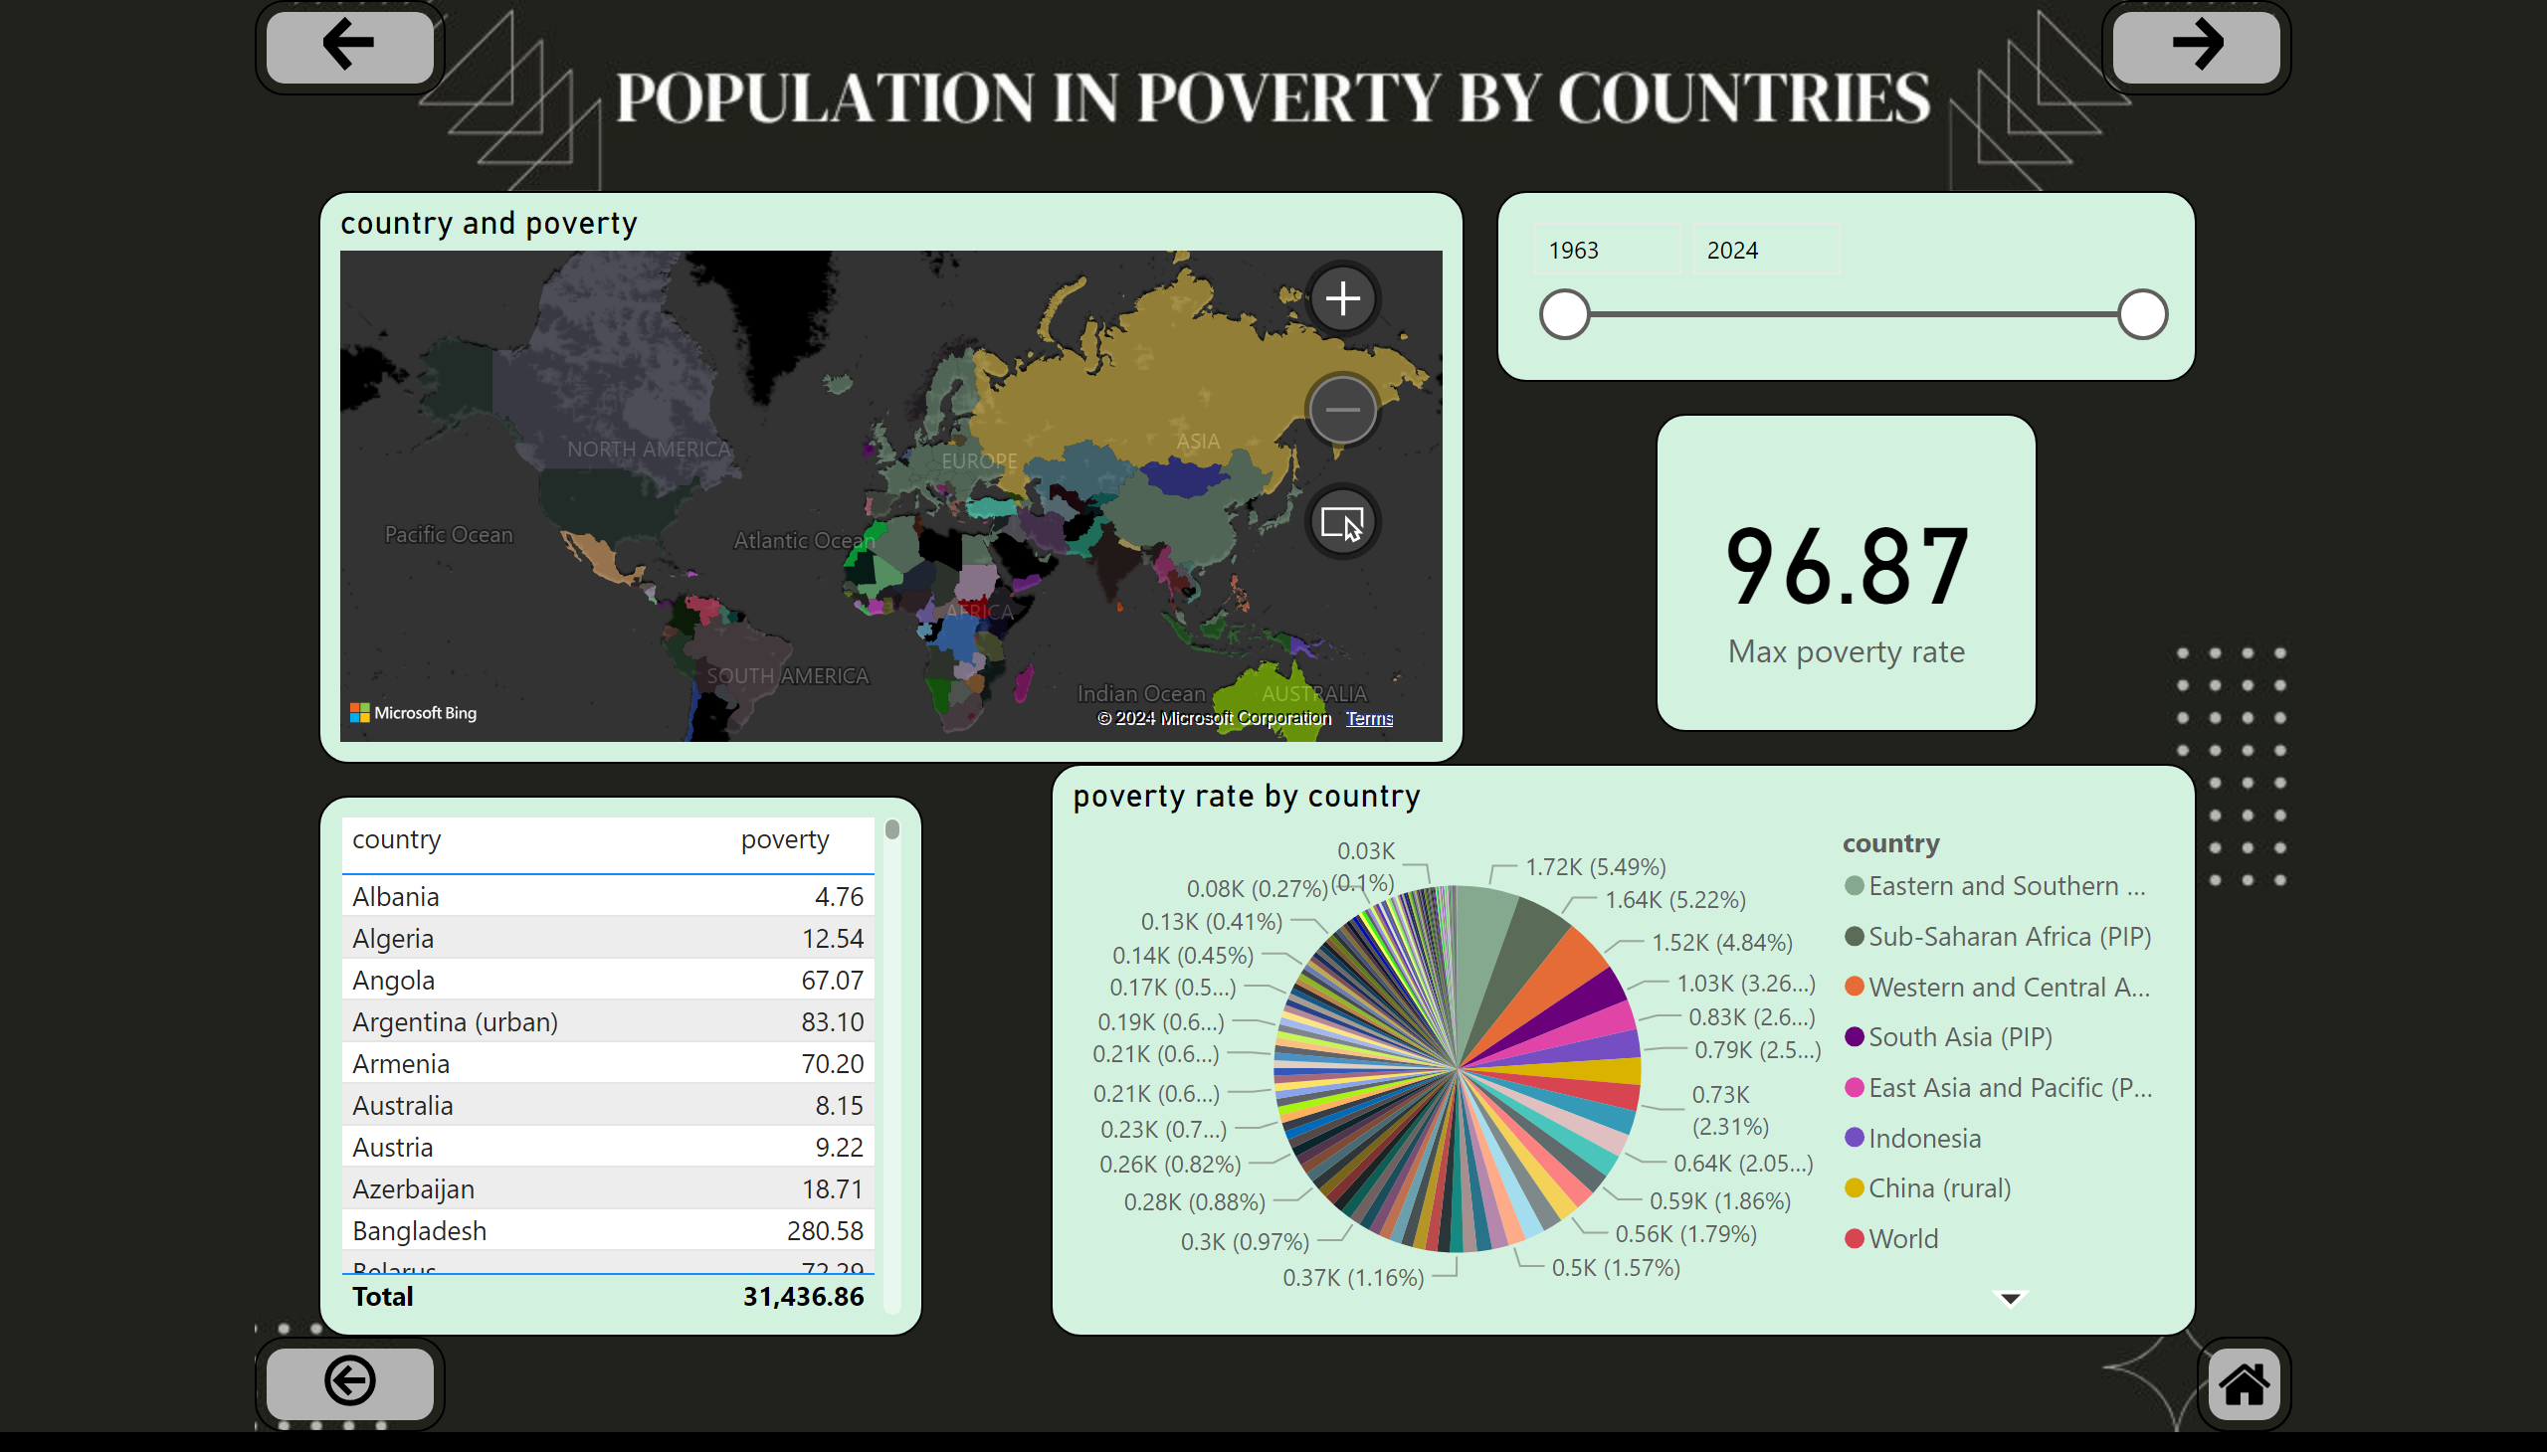
scattering poverty
Notes:
slicer
No alt text provided
tableEx
No alt text provided
pieChart
No alt text provided
card
No alt text provided
filledMap
No alt text provided
actionButton
No alt text provided
actionButton
No alt text provided
actionButton
No alt text provided
shape
No alt text provided
image
No alt text provided

Slide 22
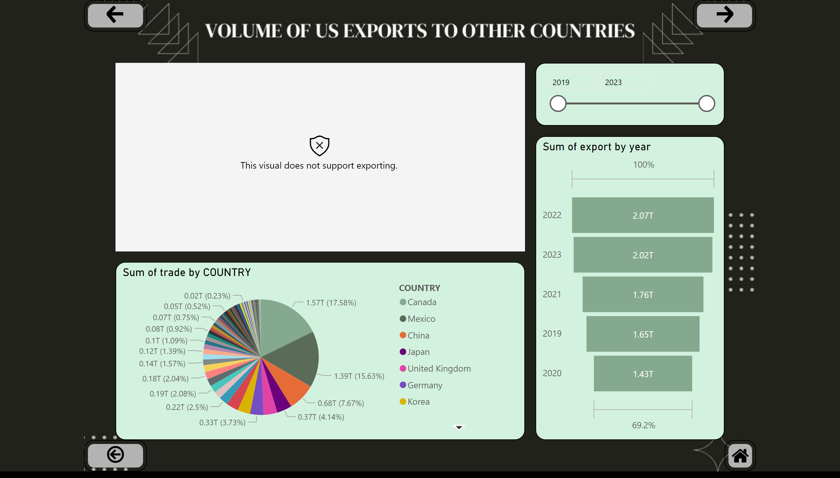
us exports to other countries
Notes:
flowmap30CFDD5B92F848C88242B1E81C8C33C7
No alt text provided
slicer
No alt text provided
funnel
No alt text provided
pieChart
No alt text provided
actionButton
No alt text provided
actionButton
No alt text provided
actionButton
No alt text provided
shape
No alt text provided
image
No alt text provided

Slide 23
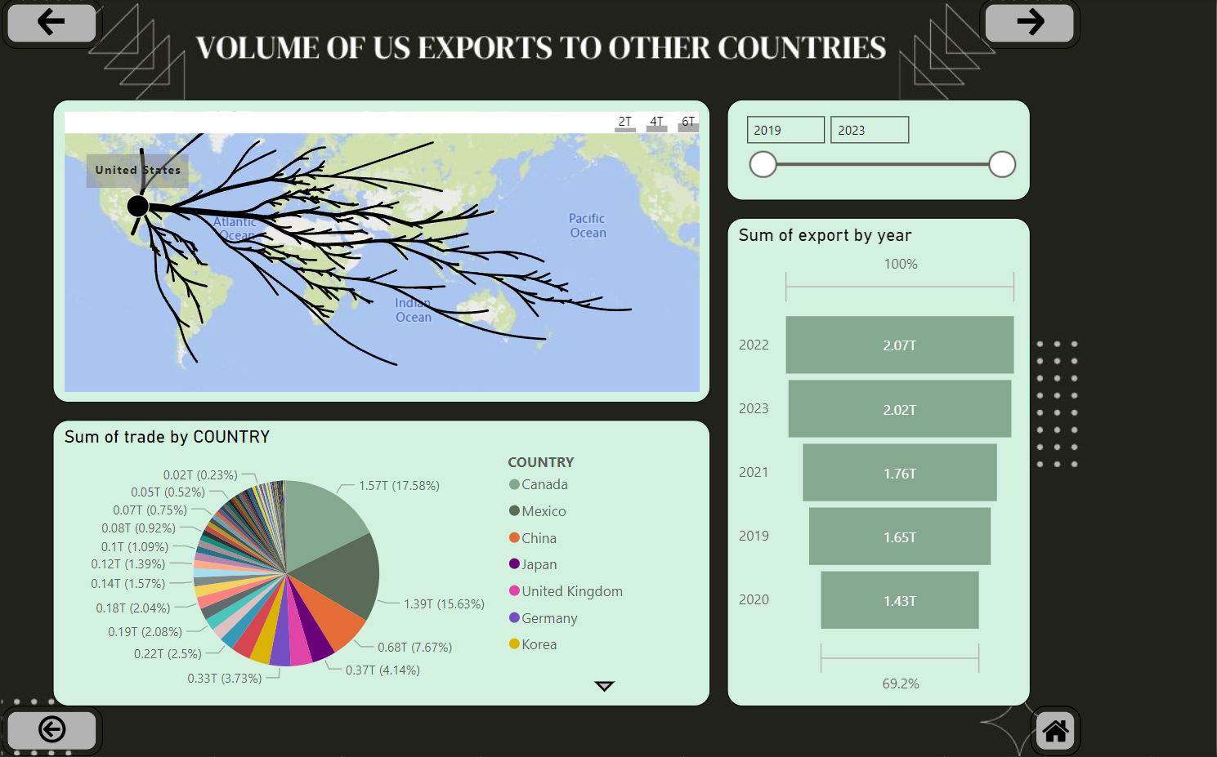

Slide 24
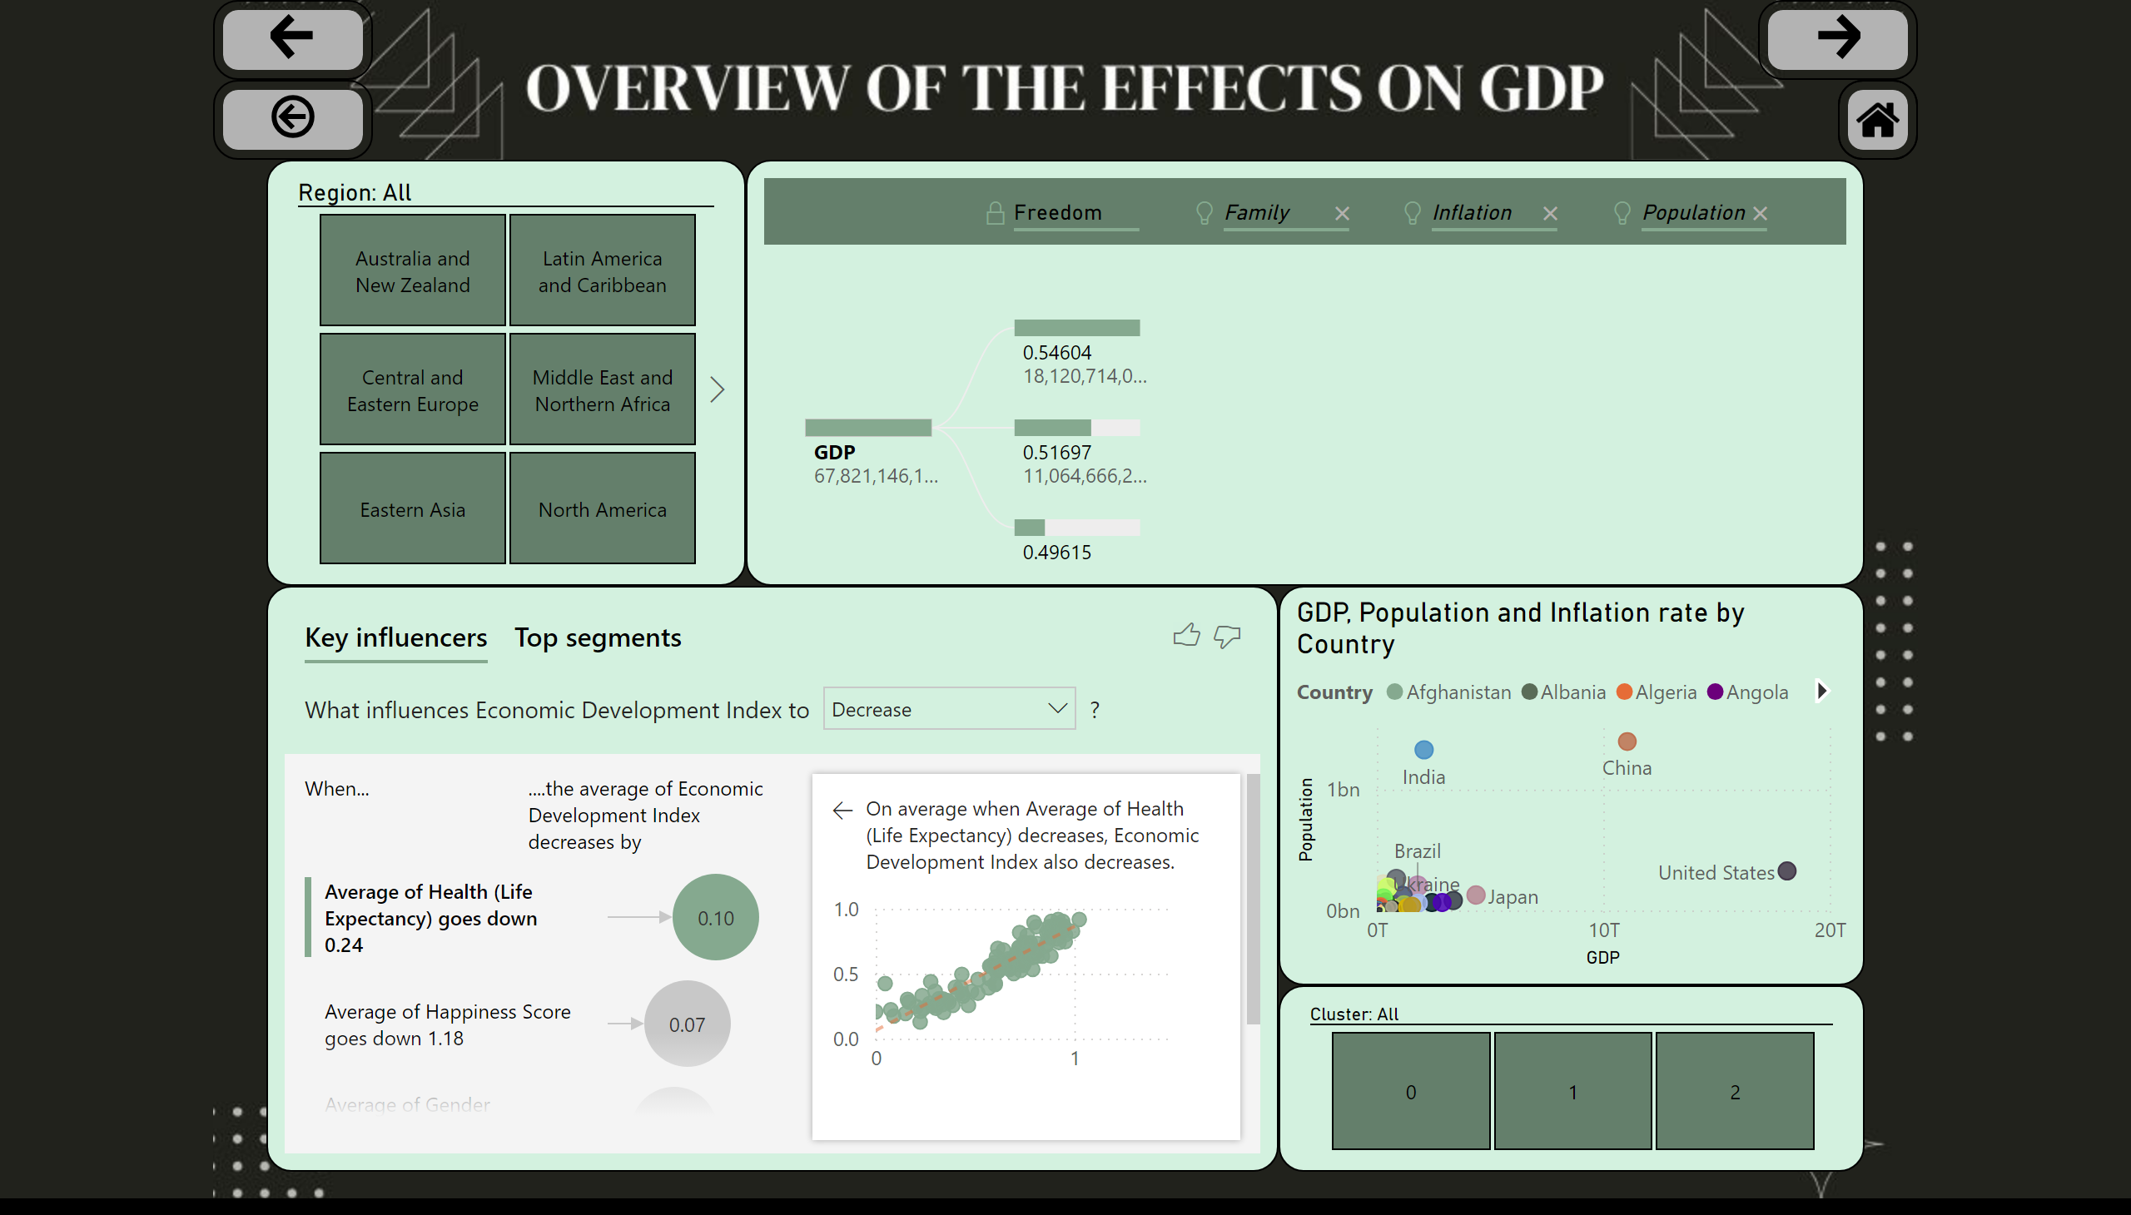
Modeling the effect of multiple variables
Notes:
decompositionTreeVisual
No alt text provided
slicer
No alt text provided
scatterChart
No alt text provided
slicer
No alt text provided
keyDriversVisual
No alt text provided
actionButton
No alt text provided
actionButton
No alt text provided
actionButton
No alt text provided
shape
No alt text provided
image
No alt text provided

Slide 25
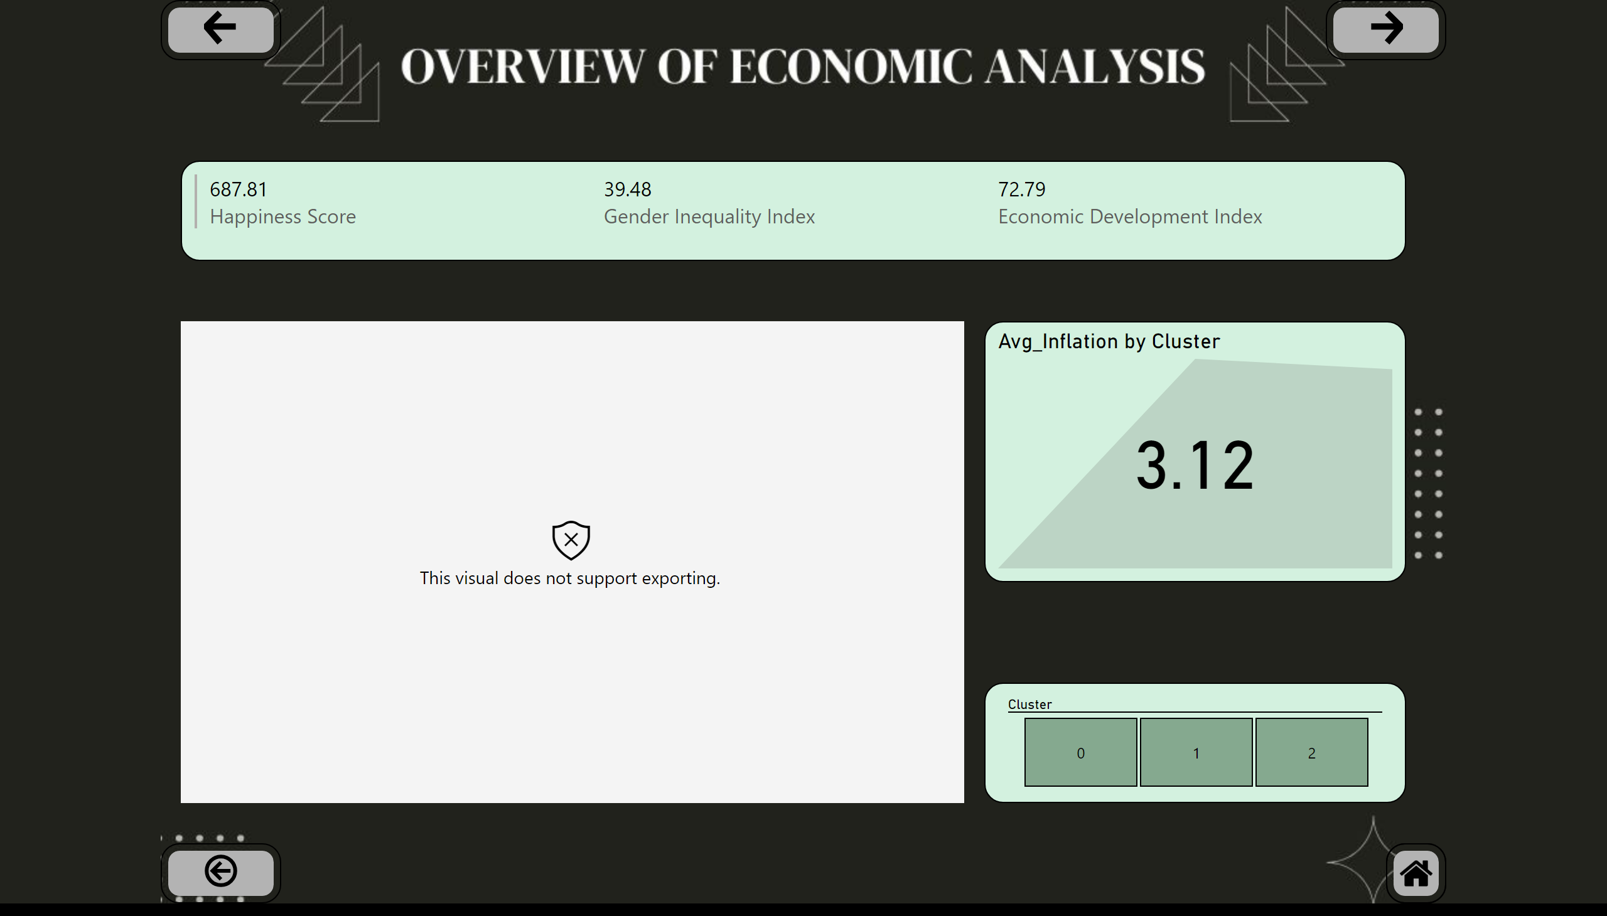
Overview of economic analysis
Notes:
multiRowCard
No alt text provided
kpi
No alt text provided
slicer
No alt text provided
esriVisual
No alt text provided
actionButton
No alt text provided
actionButton
No alt text provided
actionButton
No alt text provided
shape
No alt text provided
image
No alt text provided

Slide 26
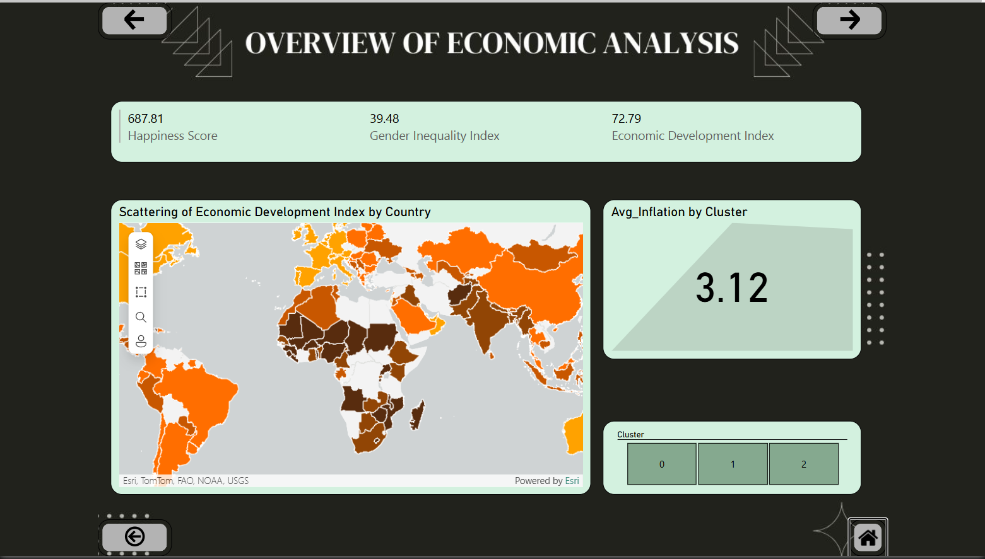

Slide 27
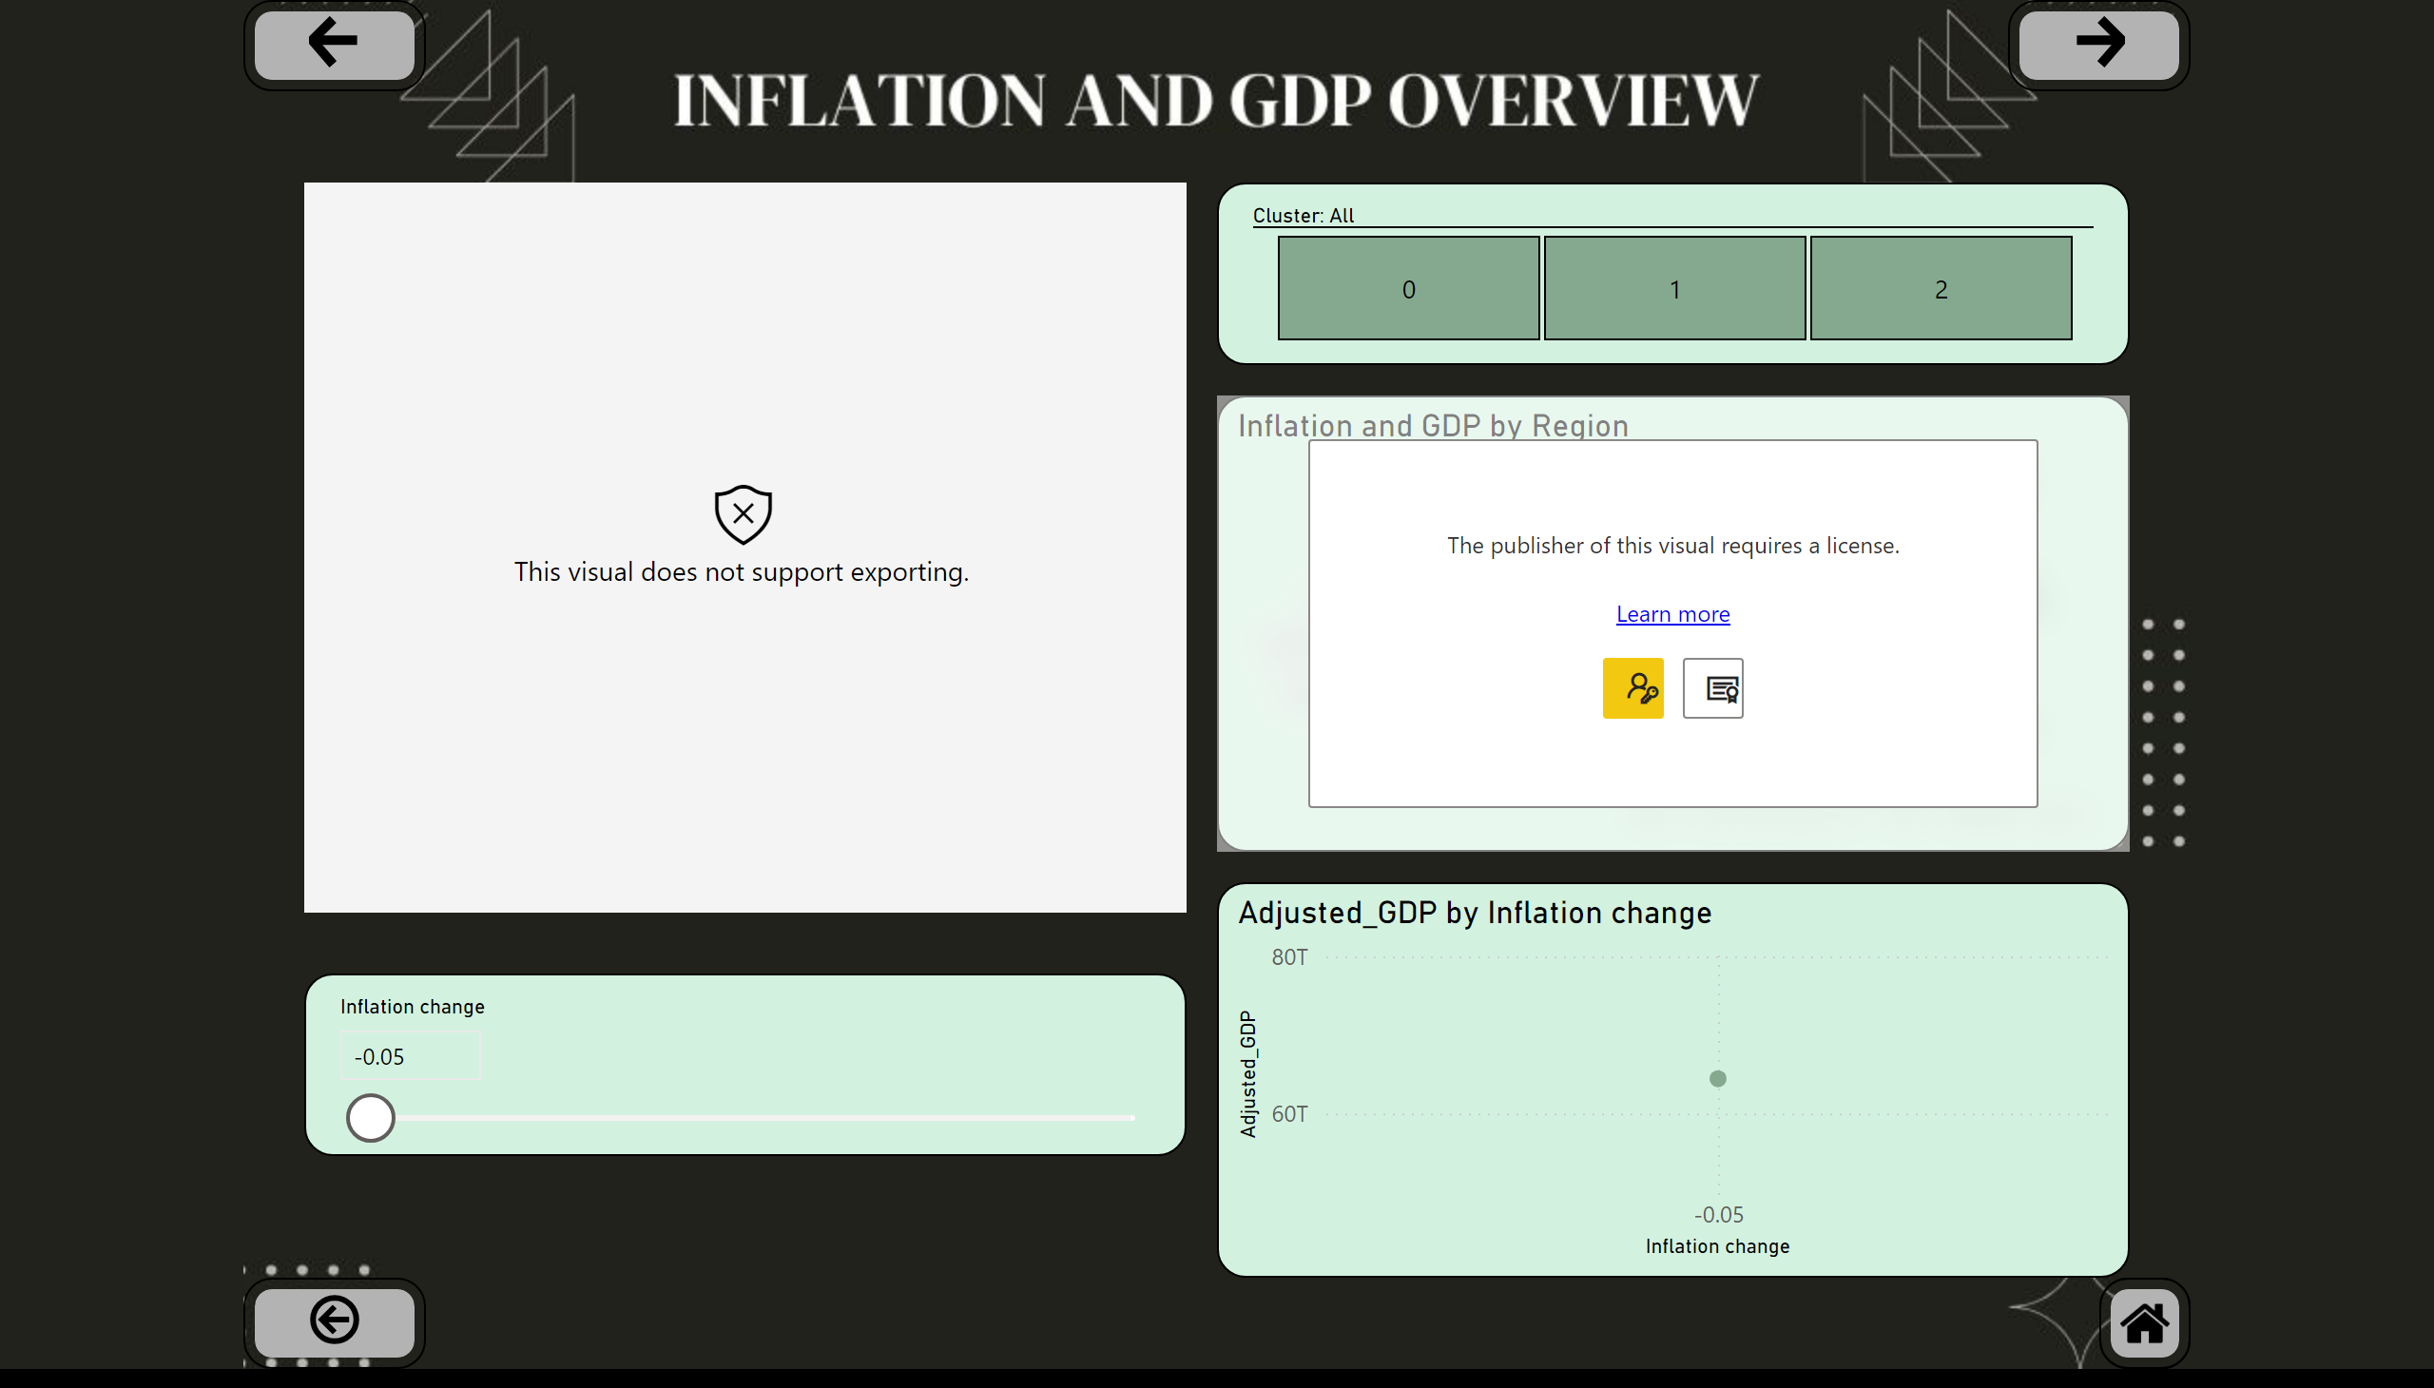
Overview of inflation with GDP
Notes:
slicer
No alt text provided
lineChart
No alt text provided
Inflation change by Country
No alt text provided
slicer
No alt text provided
Inflation and GDP by Region
No alt text provided
actionButton
No alt text provided
actionButton
No alt text provided
actionButton
No alt text provided
shape
No alt text provided
image
No alt text provided

Slide 28
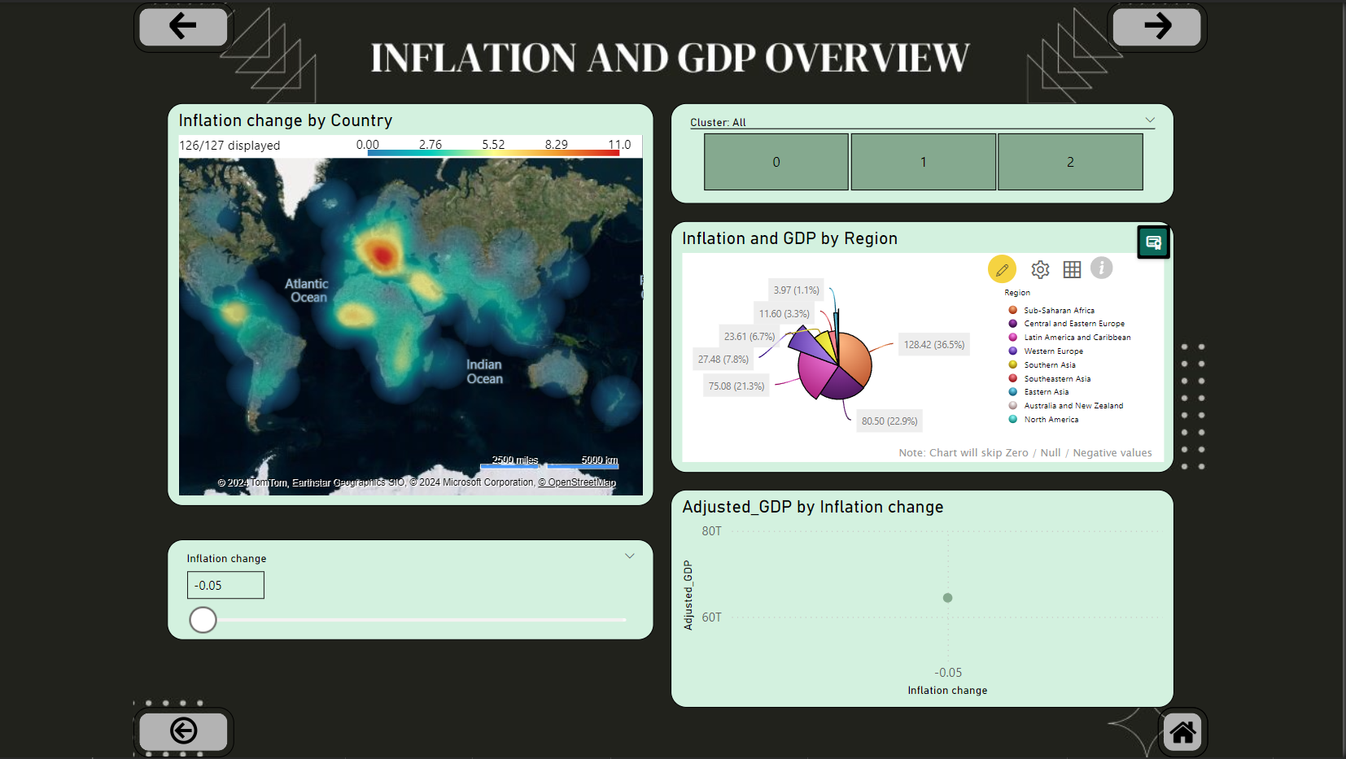

Slide 29
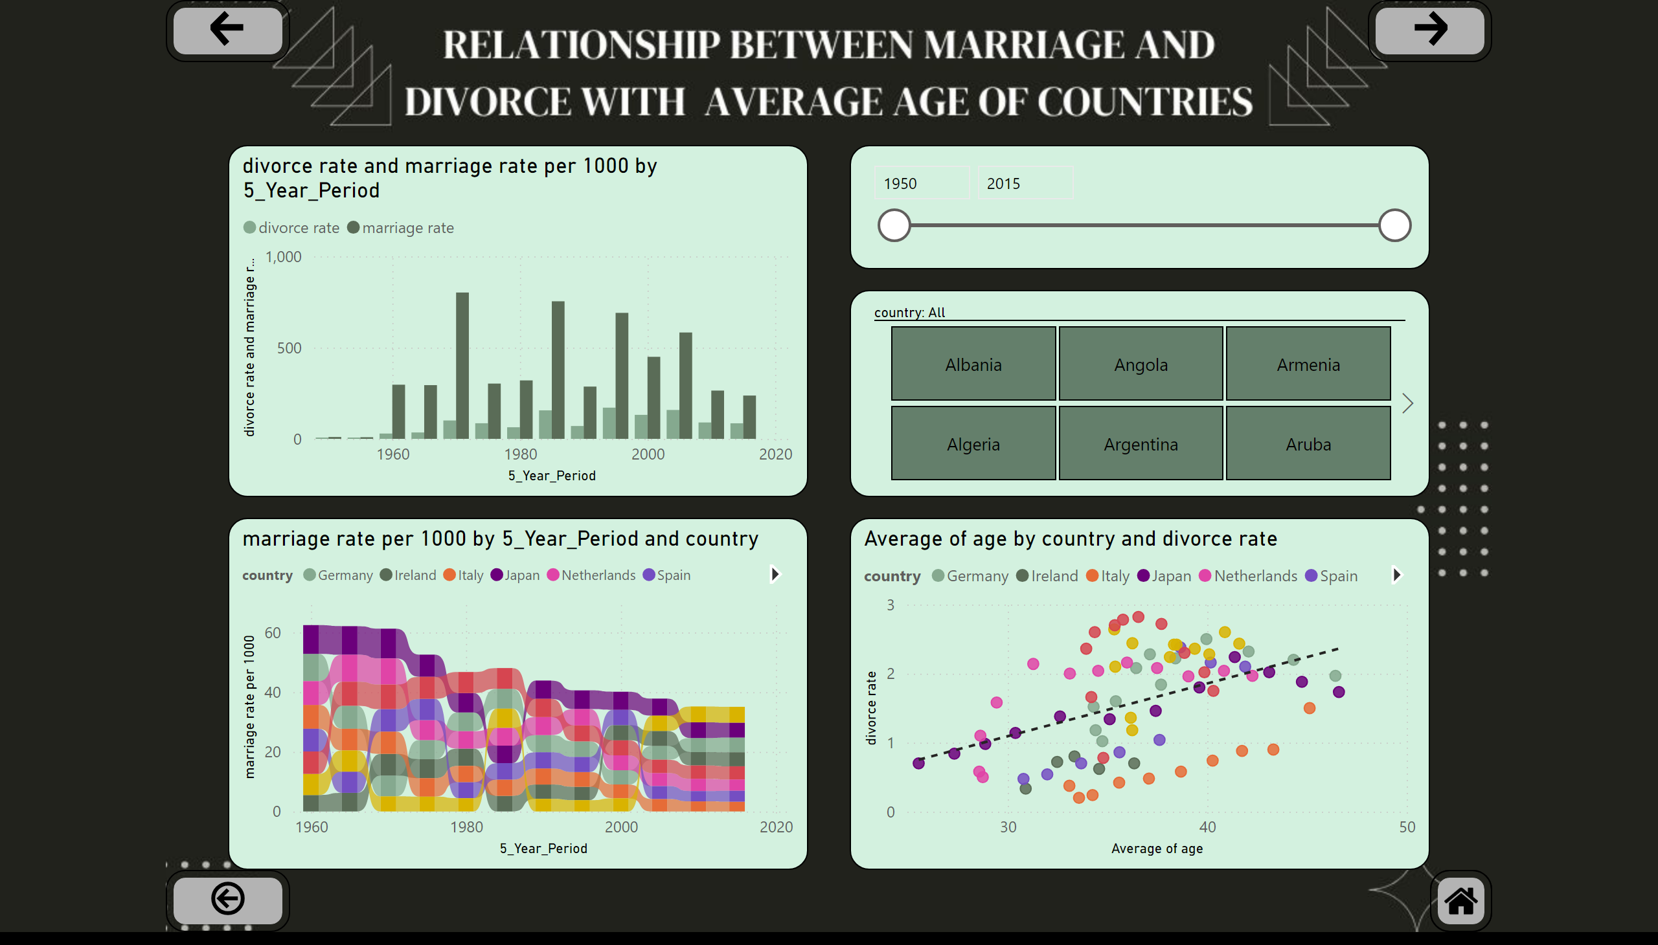
connection between marriage and divorce and age
Notes:
slicer
No alt text provided
divorce rate and marriage rate per 1000 by 5_Year_Period
No alt text provided
ribbonChart
No alt text provided
scatterChart
No alt text provided
slicer
No alt text provided
actionButton
No alt text provided
actionButton
No alt text provided
actionButton
No alt text provided
shape
No alt text provided
image
No alt text provided

Slide 30
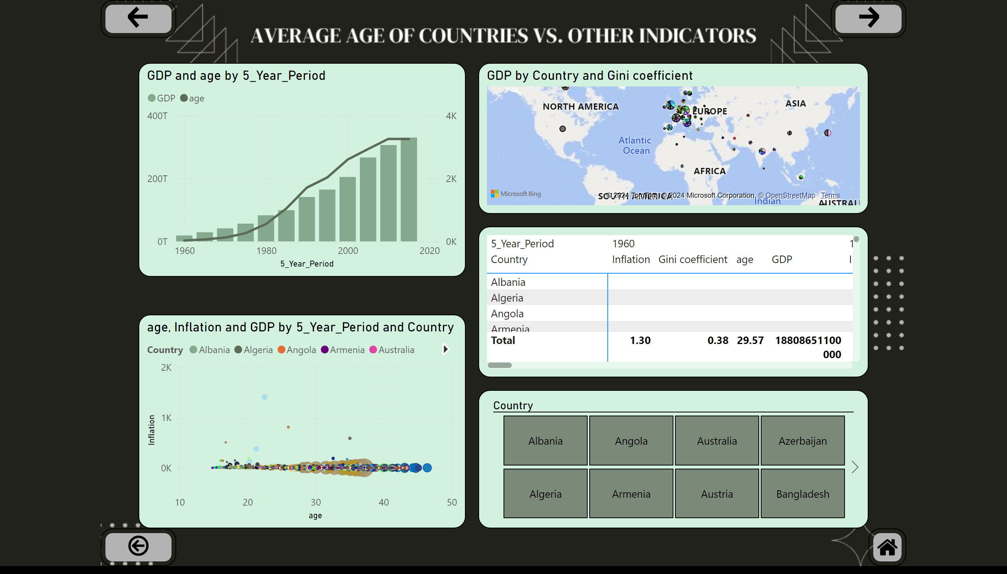
connection between age, inflation, gini and GDP
Notes:
scatterChart
No alt text provided
map
No alt text provided
lineClusteredColumnComboChart
No alt text provided
pivotTable
No alt text provided
slicer
No alt text provided
actionButton
No alt text provided
actionButton
No alt text provided
actionButton
No alt text provided
shape
No alt text provided
image
No alt text provided

Slide 31
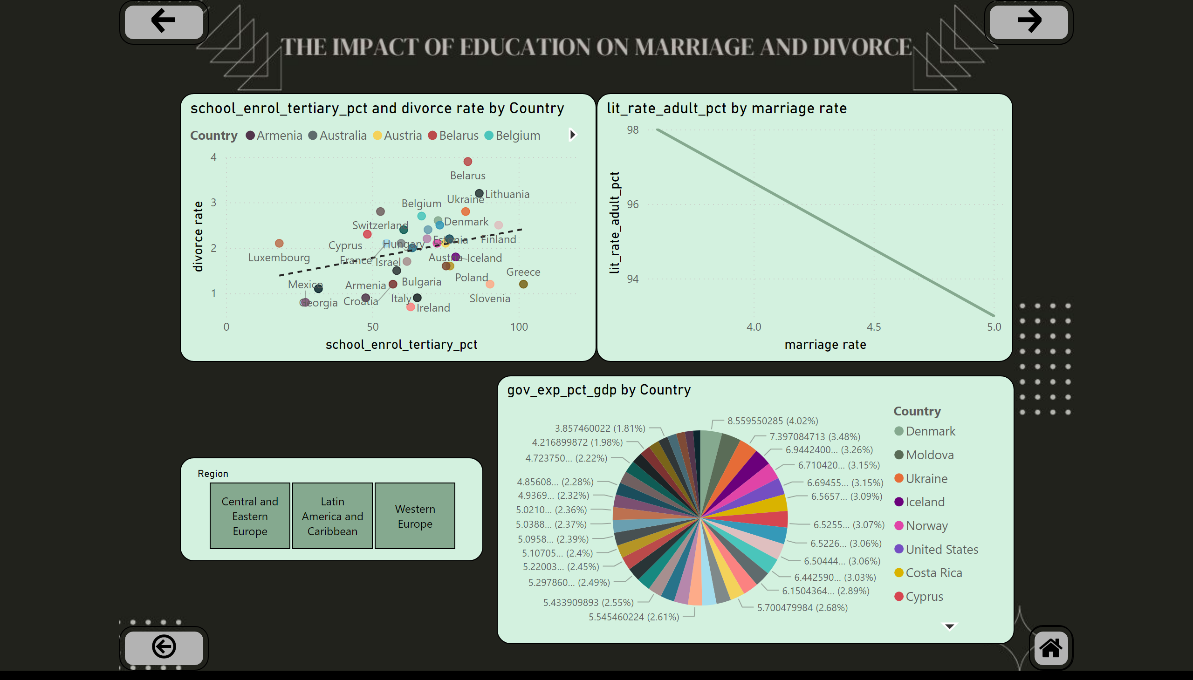
education in each country
Notes:
scatterChart
No alt text provided
pieChart
No alt text provided
slicer
No alt text provided
lineChart
No alt text provided
actionButton
No alt text provided
actionButton
No alt text provided
actionButton
No alt text provided
shape
No alt text provided
image
No alt text provided

Slide 32
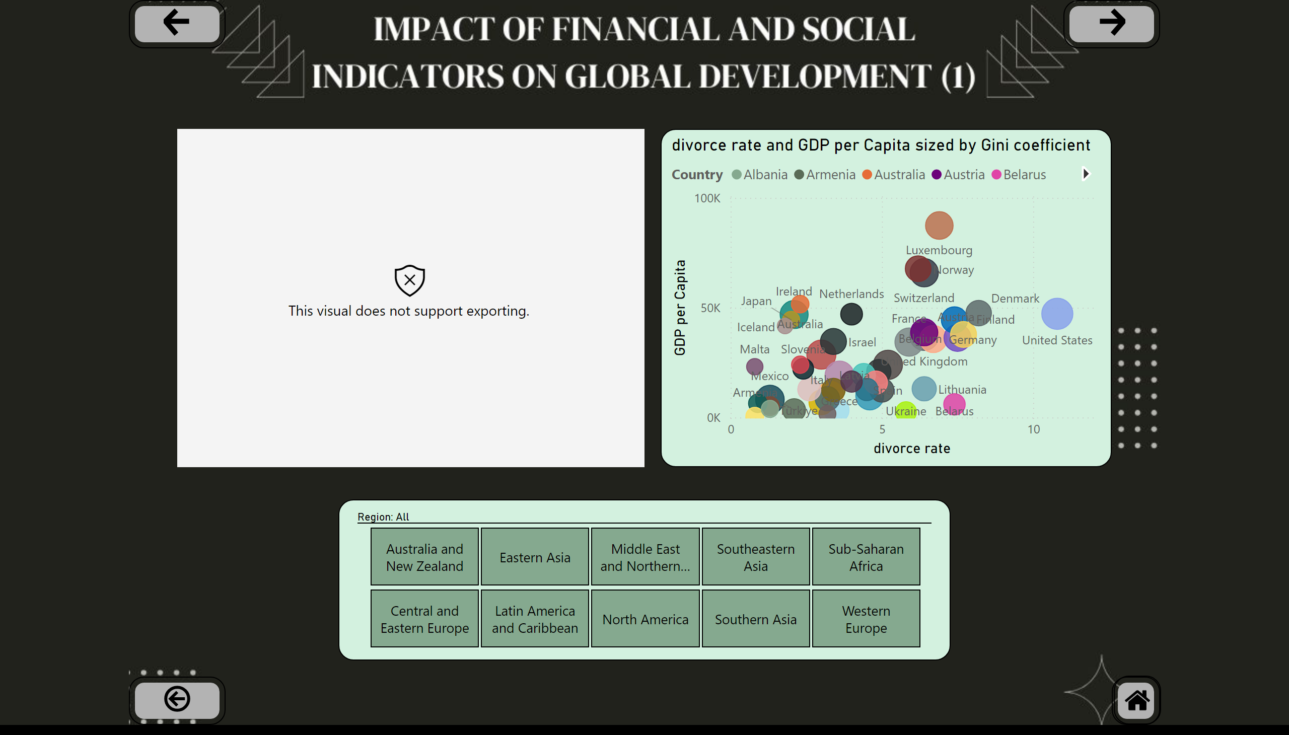
The effect of divorce rate and population on GDP
Notes:
divorce rate and GDP per Capita sized by Gini coefficient
No alt text provided
slicer
No alt text provided
actionButton
No alt text provided
actionButton
No alt text provided
actionButton
No alt text provided
shape
No alt text provided
image
No alt text provided
GDP by Country
No alt text provided

Slide 33
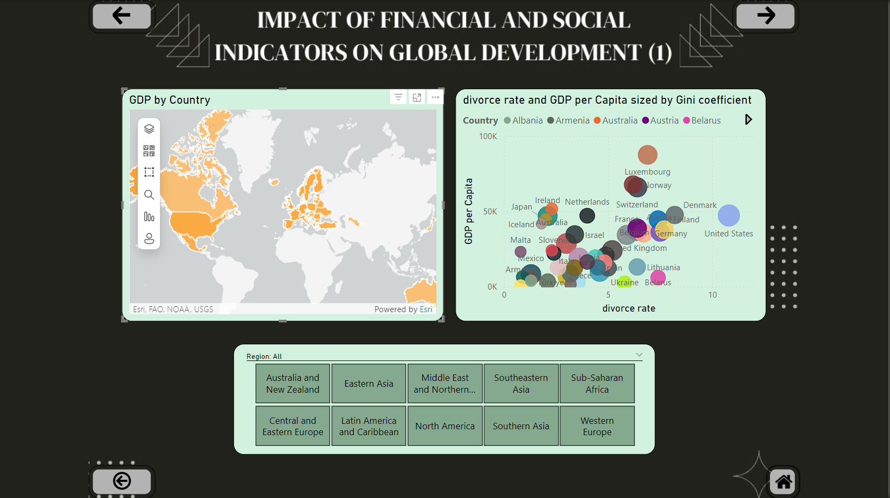

Slide 34
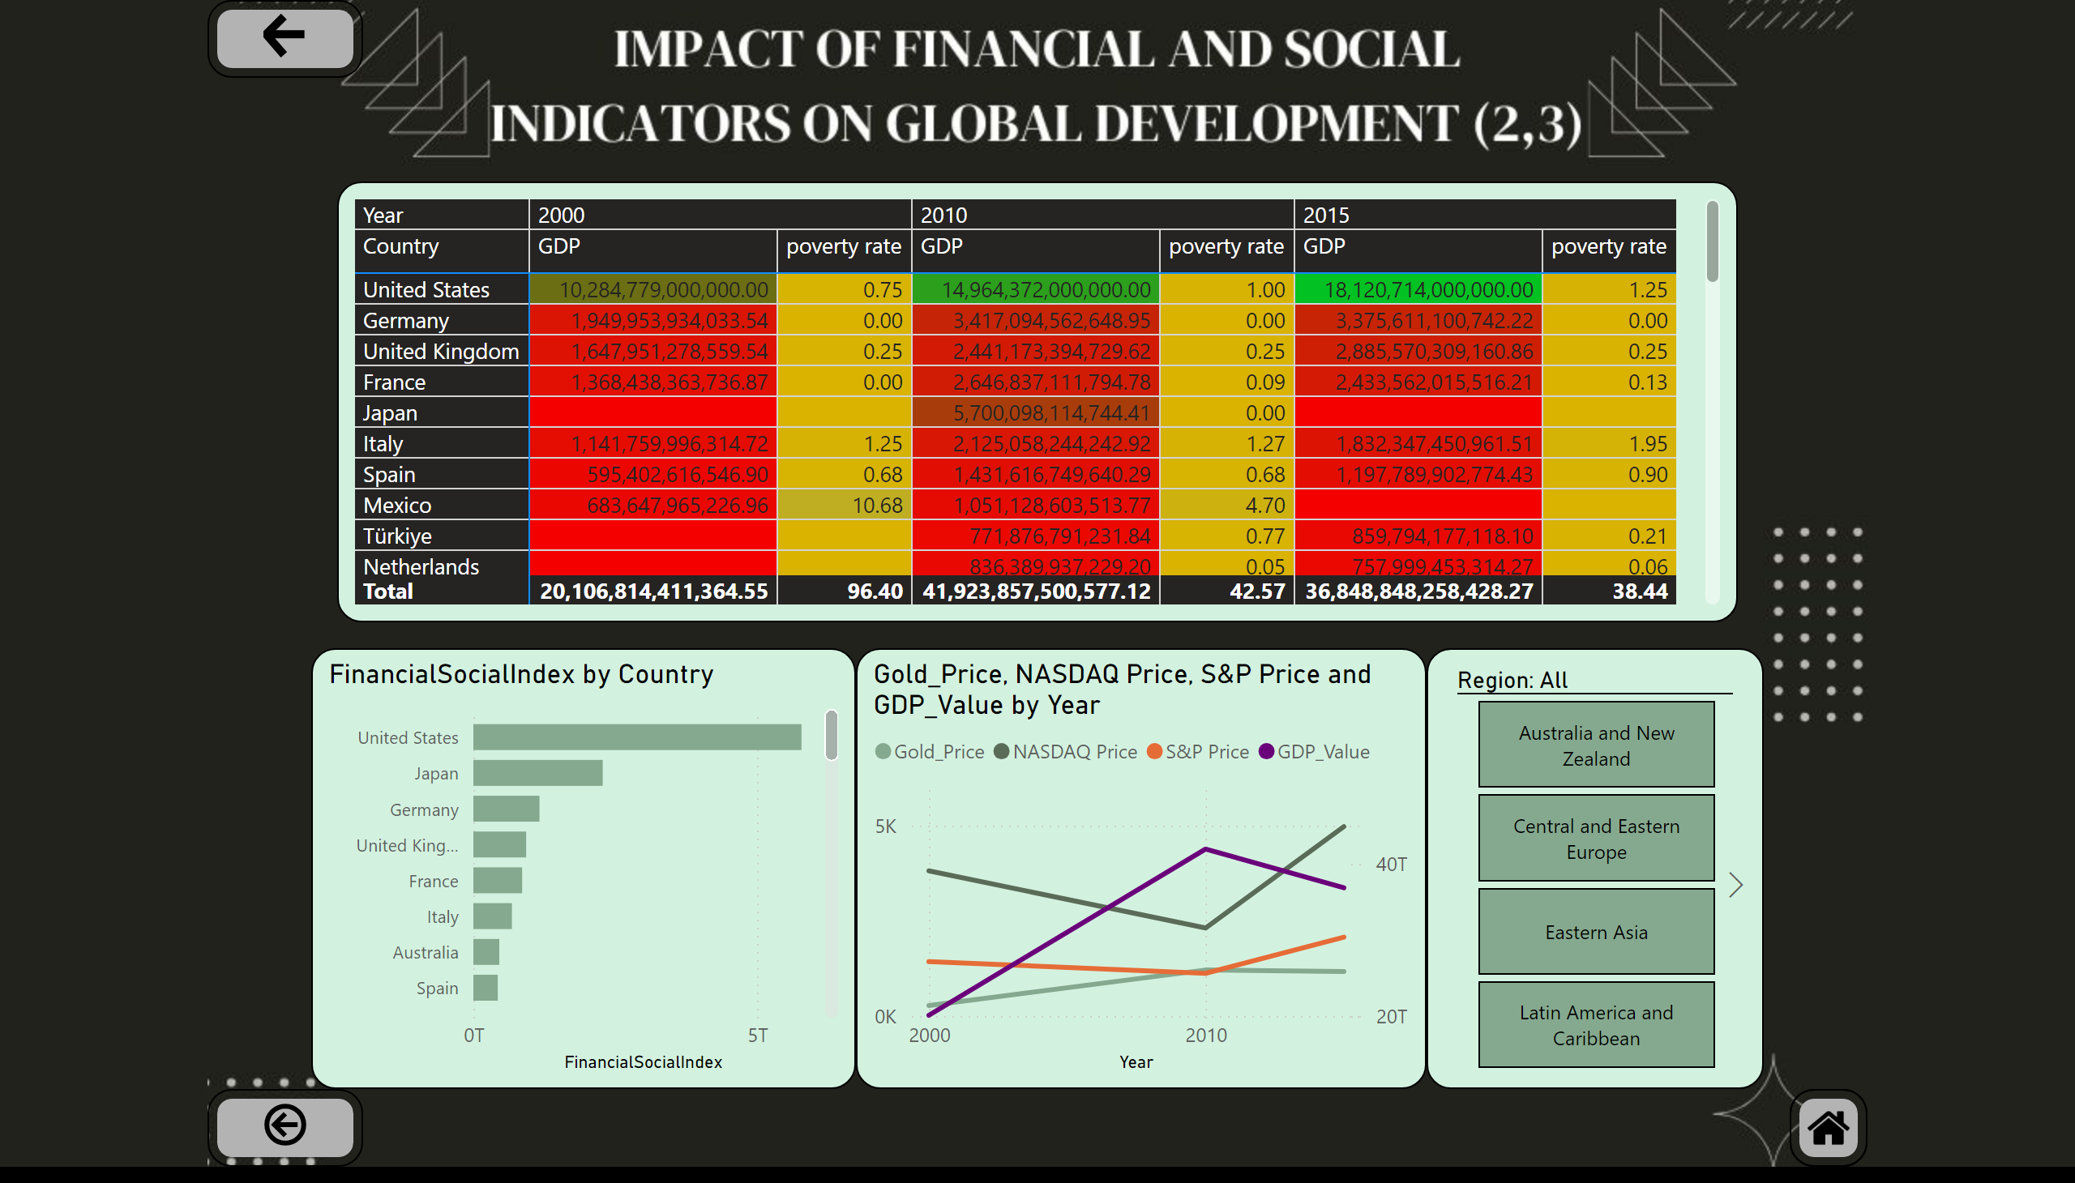
Composite index of "financial and social well-being"
Notes:
clusteredBarChart
No alt text provided
pivotTable
No alt text provided
slicer
No alt text provided
lineChart
No alt text provided
actionButton
No alt text provided
actionButton
No alt text provided
shape
No alt text provided
image
No alt text provided

